Slide 1
2024 TTT Live Demo Chi-Mei medical center, case 6 Final report
AIMS: RCA ostium-CTO
2024.01.07

Slide 2
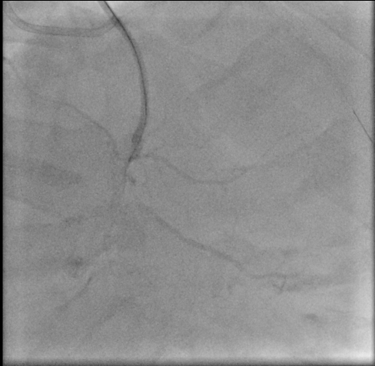
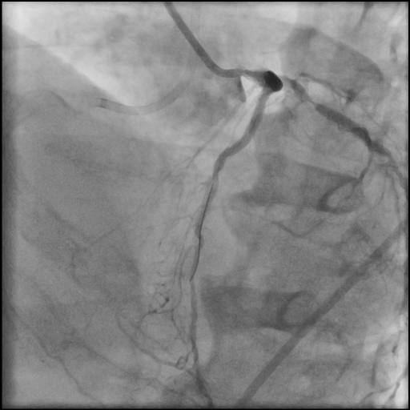
Before PCI
RCA-ostium total occlusion
Critical ISR of DES deployed at LCX-P

Slide 3
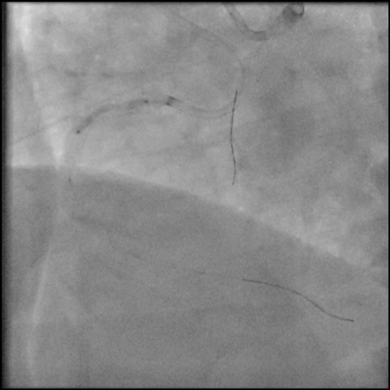
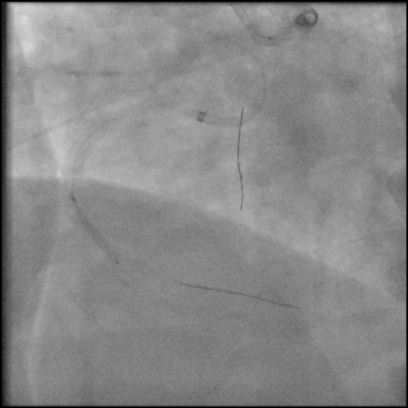
Dilated CTO along RCA-P to RCA-D with NC balloon 2.5x20mm

Slide 4
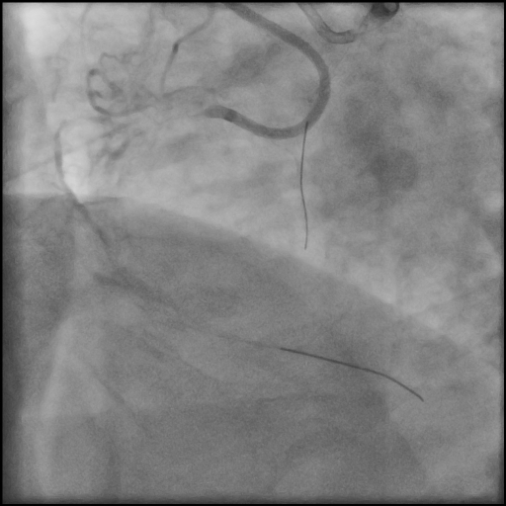
Post balloon dilatation
There is several dissection and still no flow in RCA

Slide 5
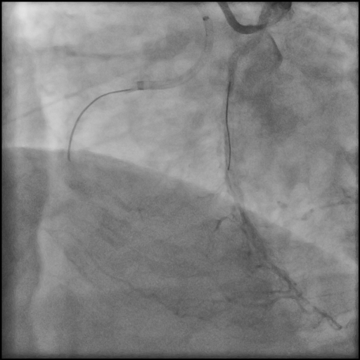
Fail for revascularization of RCA CTO
Use extension catheter to transport balloon with bigger profile
Guiding catheter lose with wire leave RCA, and difficult to find the way back to true lumen

Slide 6
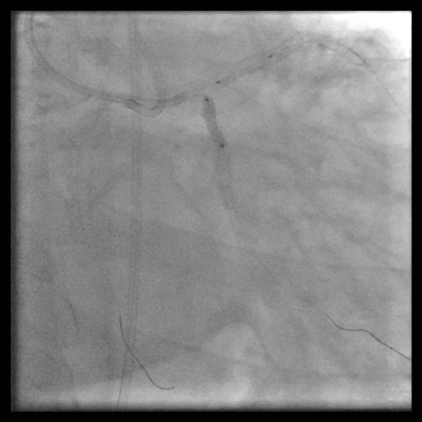
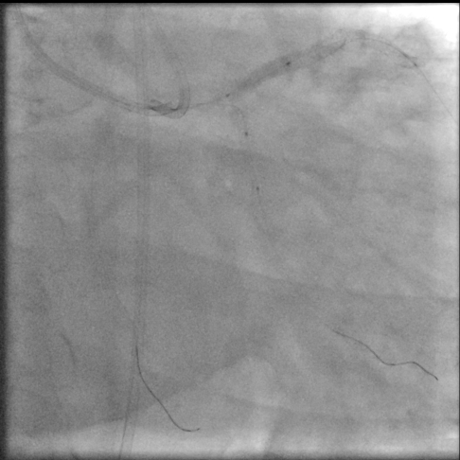
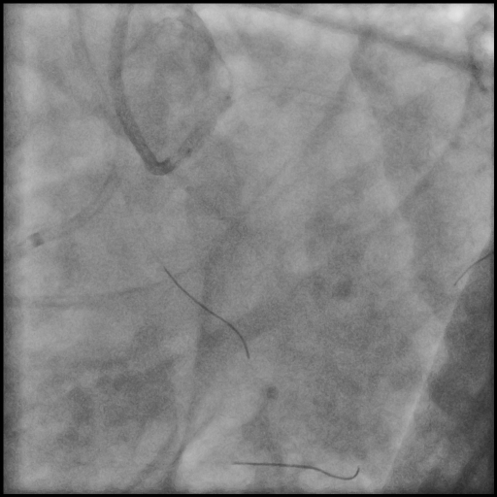
Management of LCA ISR
3.0 x15mm NC balloon for ISR of LCX-P
3.75 x15mm NC balloon for ISR of LAD-P
balloon kissing for LM bifurcation lesion
Proximal optimization technique for LM

Slide 7
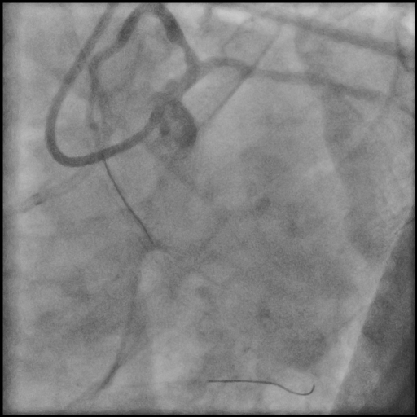
Final CAG for LCA
CAU
CAU + LAO
The patient discharged on next day

