Slide 1
Case 4: LAD Ostium CTO
2024-01-06
Operator: Chien Lin, Lee
Far Eastern Memorial Hospital

Slide 2
LAD Ostium CTO

Slide 3
IVUS Guided, Crusade Assisted, Gaia3 Puncture

Slide 4
UB3 into D1
Cross Corsair to D1 under LCX anchoring

Slide 5
IVUS: Os-D1 all intra-plaque
SC 2.0x20mm dilatation

Slide 6
Crusade assisted, UB3 puncture
IVUS from D1, LAD GW at mid-LAD

Slide 7
Gaia 2, Subintima
Parallel wire Gaia2 /
Gaia Next 2→Gaia Next3, subintima

Slide 8
Try Retrograde from RCA, difficult to cross channel and back to antegrade

Slide 9
Parallel wire, Gaia Next 3 / Conquest-12 Subintima

Slide 10
Parallel wire, Conquest 12/ Conquest 8-20, better aligment

Slide 11
Conquest 8-20 Puncture into Distal Cap

Slide 12
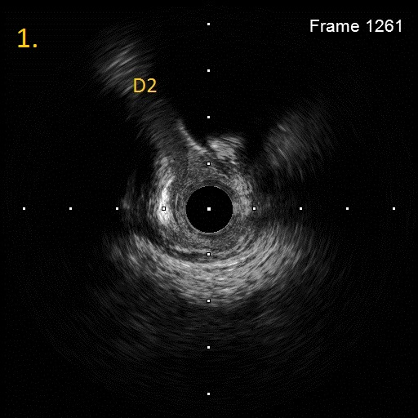
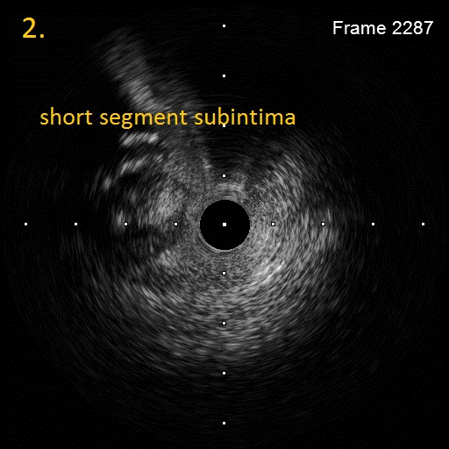
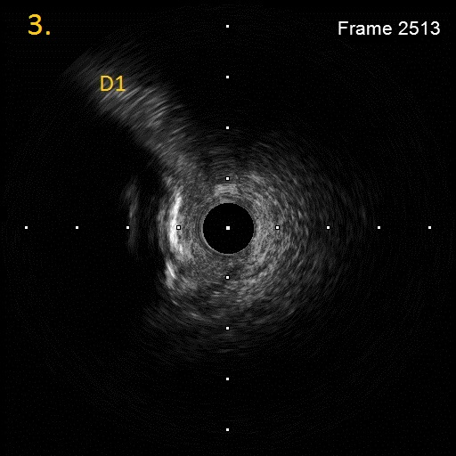
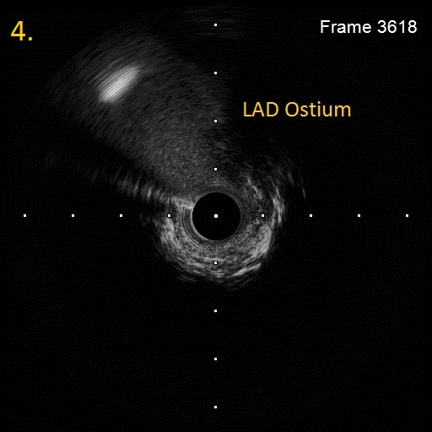

Slide 13
Final angiogram (EES*3 to LM)

Slide 14
Final Angiogram

Slide 15
Thank You

