Slide 1
Case 5 - LAD CTO
Date: 2024/01/06
Operator: Dr. Tse-Min Lu
Far Eastern Memorial Hospital

Slide 2
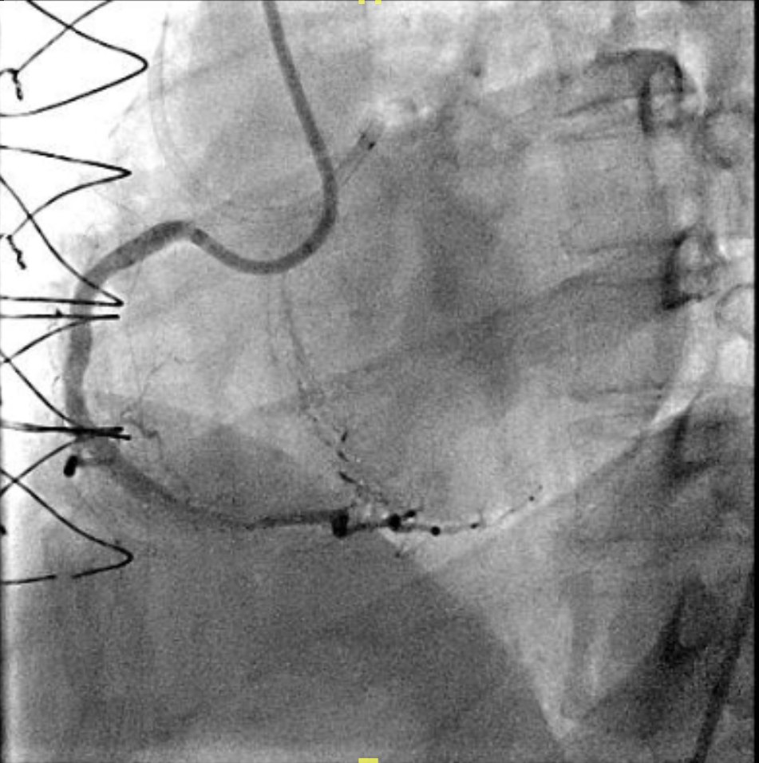
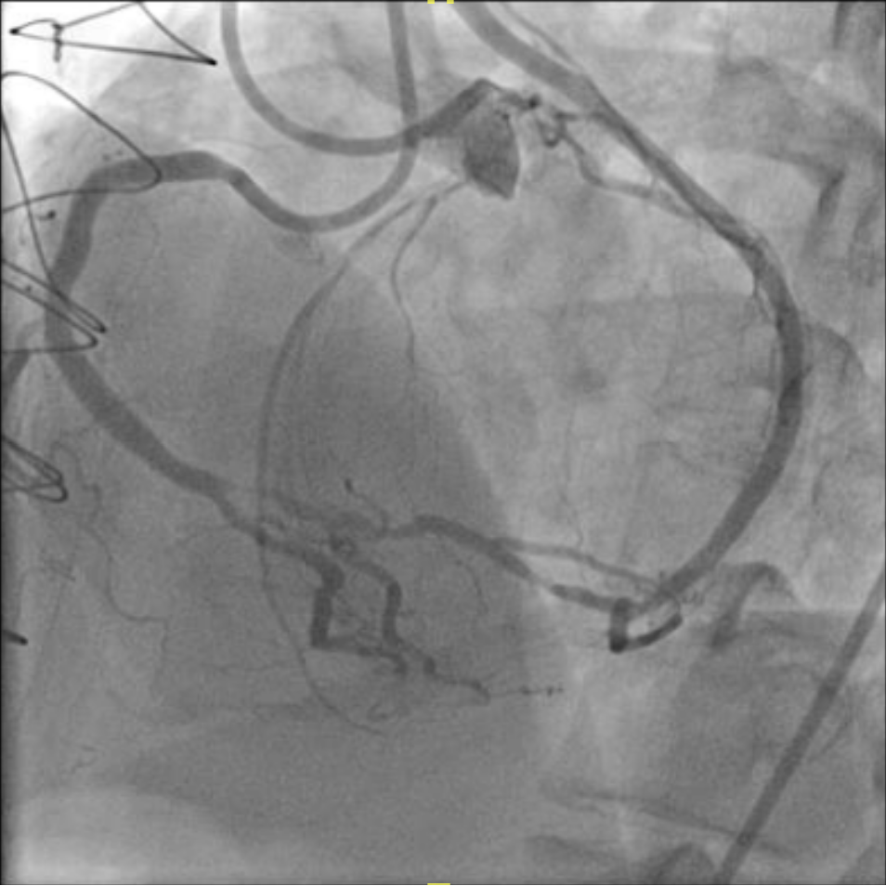
No RCA DES instent restenosis
SVG to RPL :Patent.

Slide 3
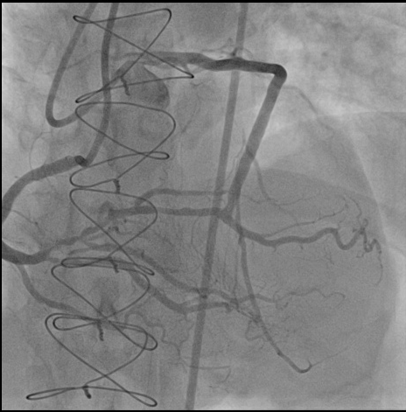
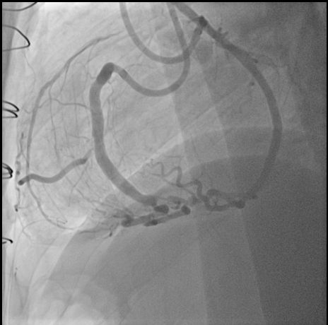
LAD proximal : 100% stenosis.

Slide 4
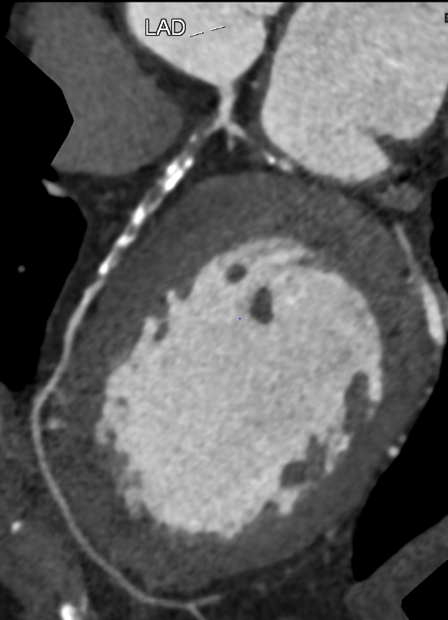
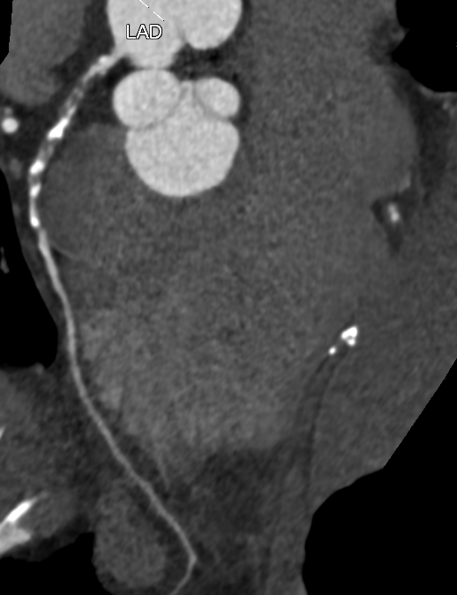

Slide 5
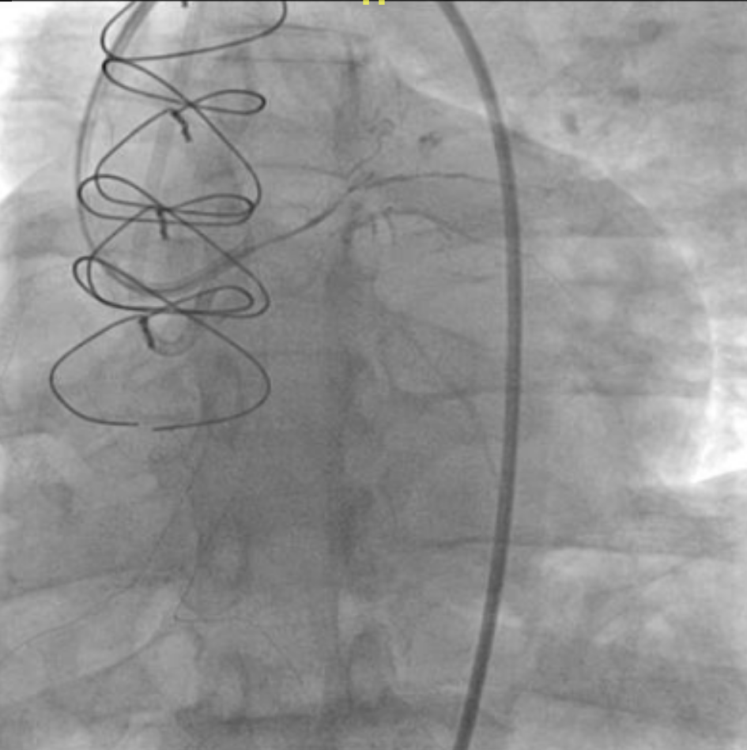
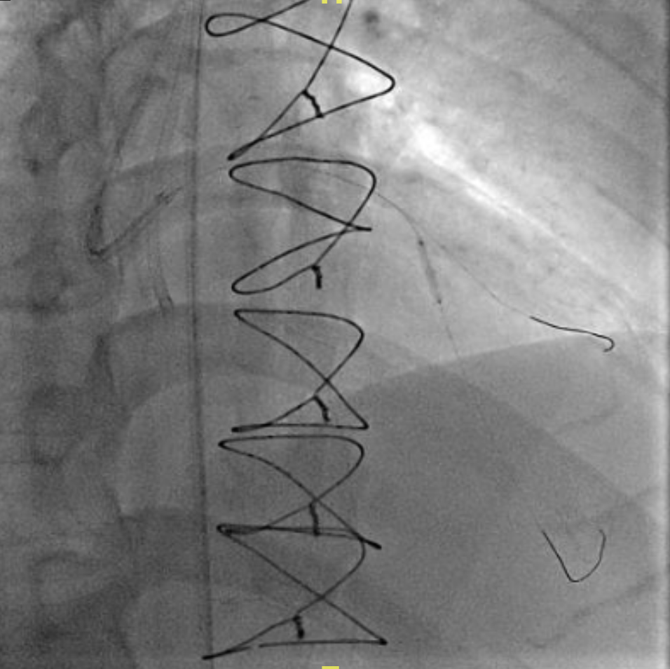
LAD proximal : 100% stenosis.
Antegrade wire(Gaia next 1) crossing proximal LAD.

Slide 6
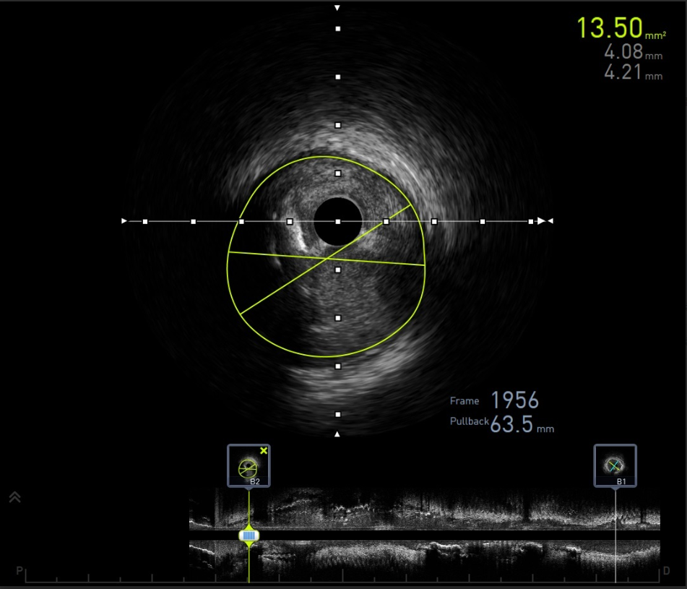
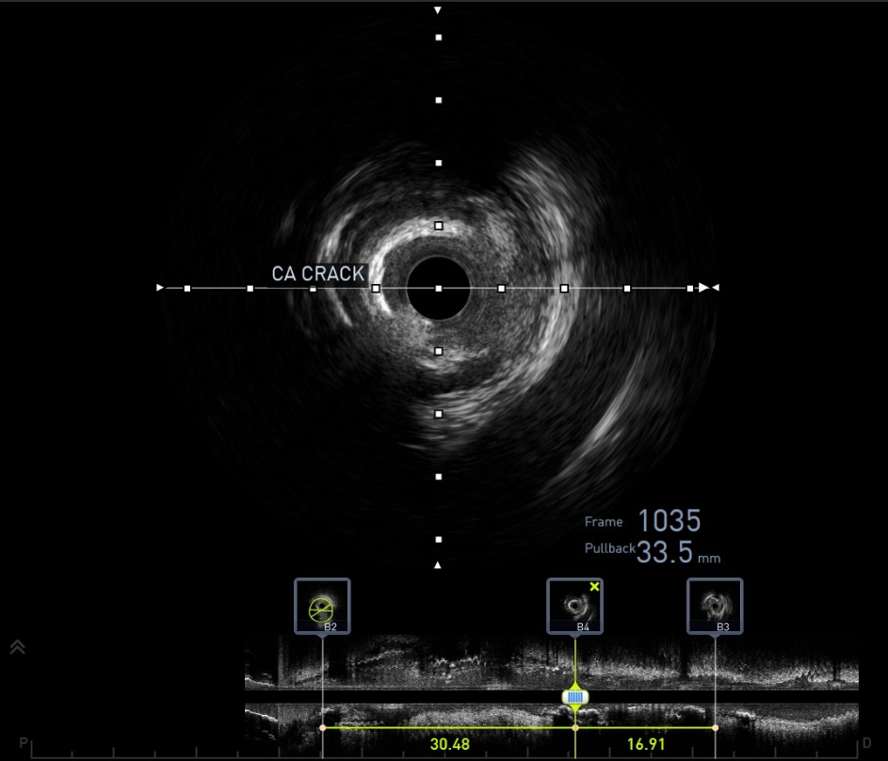
IVUS: After POBA to proximal LAD, calcified crack was noticed.

Slide 7
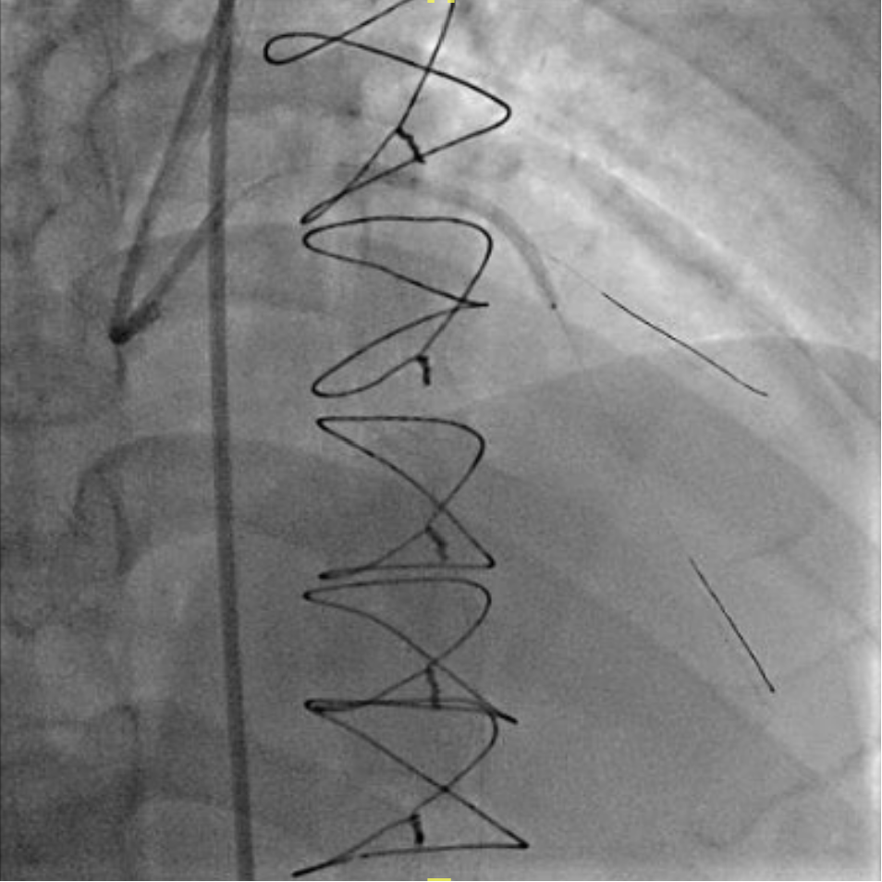
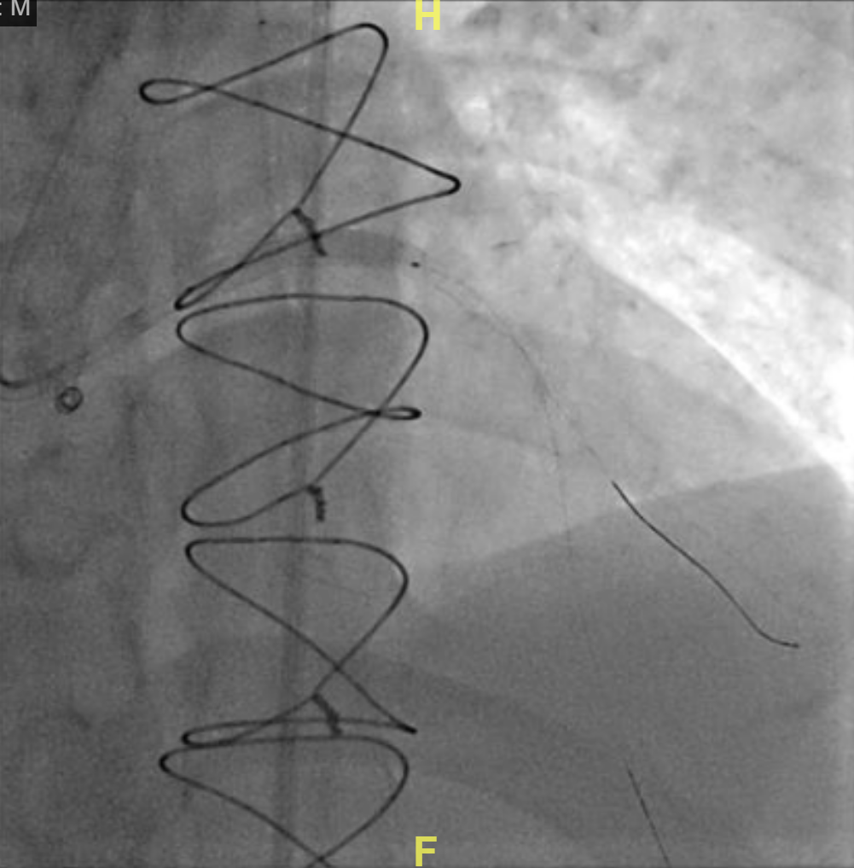
POBAS from mid-LAD to LM with DES x2.
(Onyx 2.5x38mm and 3.5*26 mm).

Slide 8
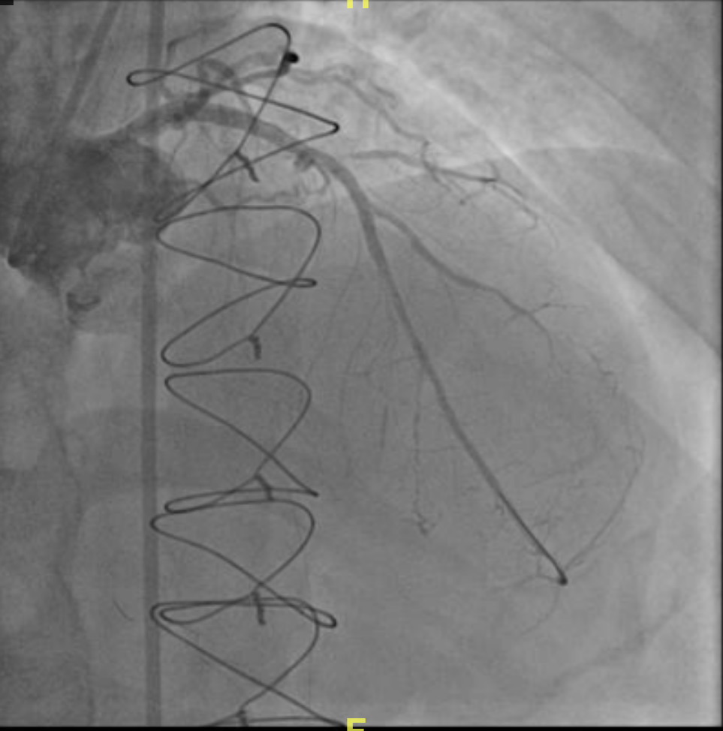
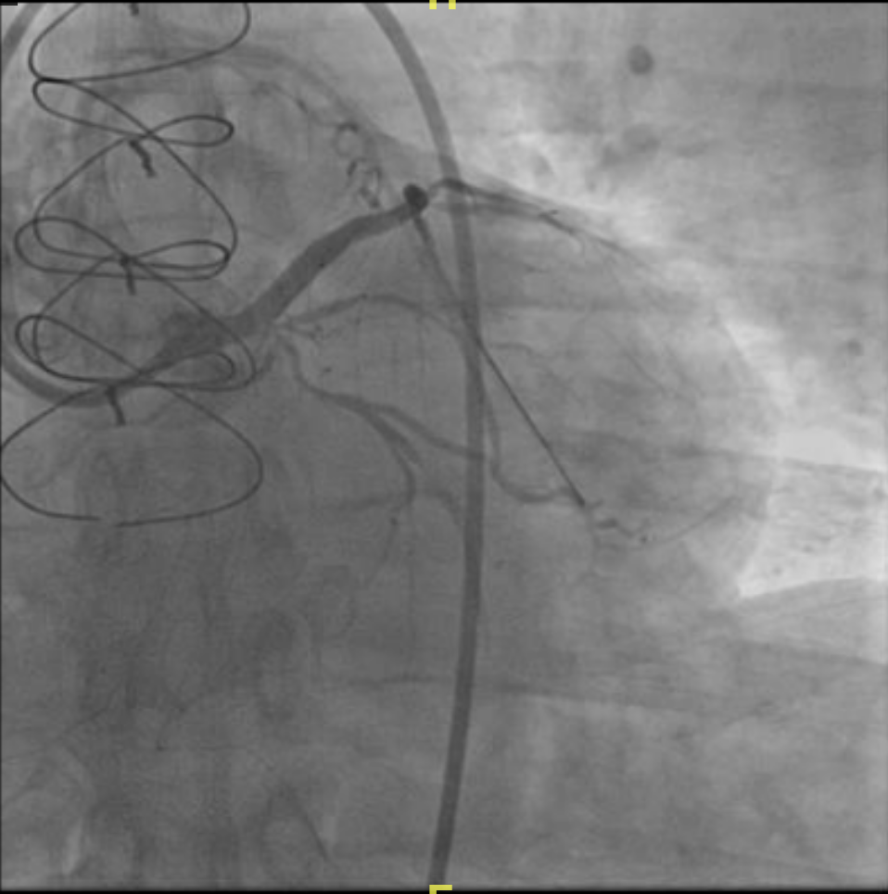
Final angiography s/p POBAS from mid-LAD to LM with DES x2.
(Onyx 2.5x38mm and 3.5*26 mm).

Slide 9
After cardiac catheter s/p POBAS from mid-LAD to LM with DES x2 (Onyx 2.5x38mm and 3.5*26 mm), we kept the patient’s DAPT with aspirin and Ticagrelor.
Under the stable condition, the patient was discharged the next day.

Slide 10
Thank you!

