Slide 2
Session II – Room 3：應O雲 Operator: Dr. 李任光
Clinical presentation
81 y/o woman with right lower limb intermittent claudication for 1 year
Past medical history
End-stage renal disease under hemodialysis
Diabetes
HTN
Sick sinus syndrome with DDDR implantation
Medication
Plavix 1# qd, pletaal 1# bid
Notes:
48806731

Slide 3
Session II - Room 3：Left CFA critical stenosis with heavy calcification
Operator: Dr. Lee
Target: Left CFA critical stenosis with heavy calcification

Slide 4
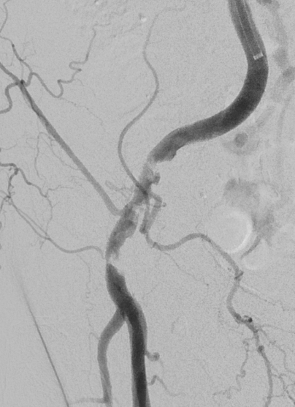
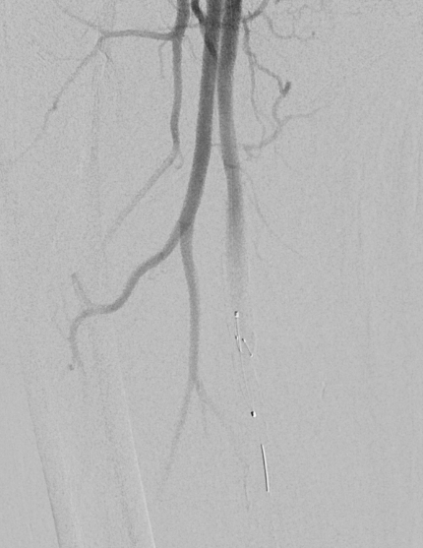
Diagnosis: Right CFA critical stenosis w/ heavy calcification
SpiderFx 6.0mm Embolic Protection Device in SFA

Slide 5
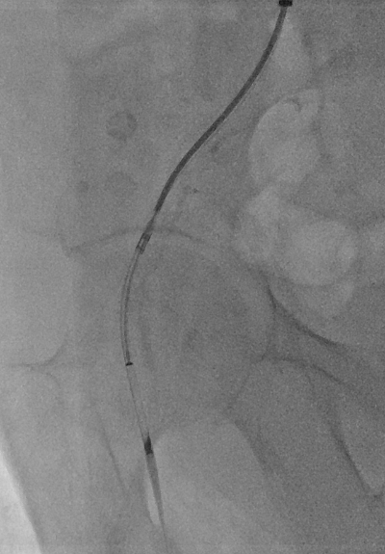
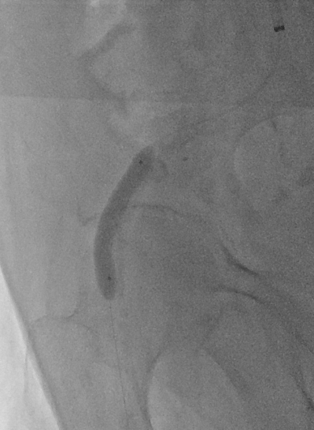
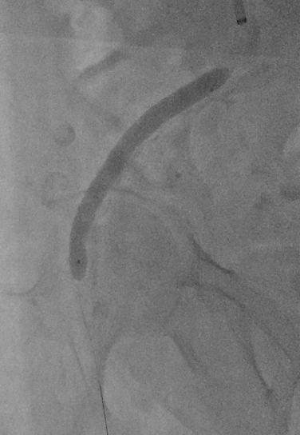
HawkOne Directional Atherectomy 7 Fr
POBA w/ Pacific Plus 6.0 x 40mm OTW
In-Pact 7.0 x 80mm DEB

Slide 6
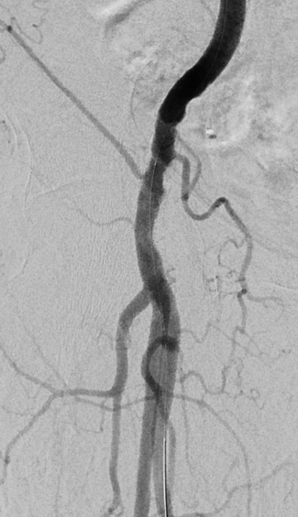
Before PTA
Final angiography

