Slide 1
2024 TTT Live Demo Chi-Mei medical center, case 1 Final report
Aims: 2 segmental CTO of RCA How to treat a bifurcation after RCA-CTO
2024.01.07

Slide 2
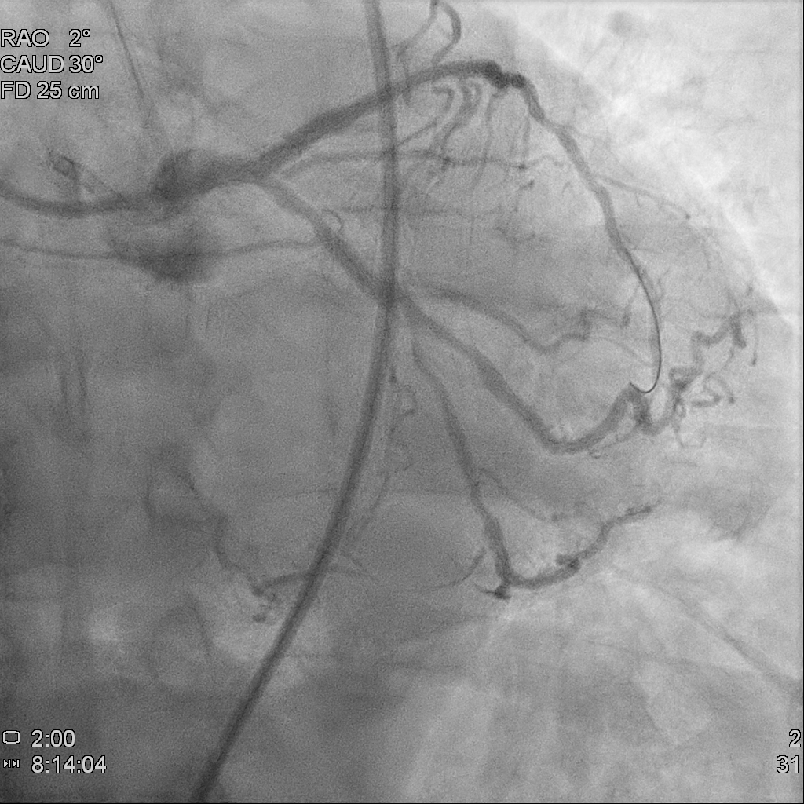
Patent LAD and LCX after 6 times of PCI

Slide 3
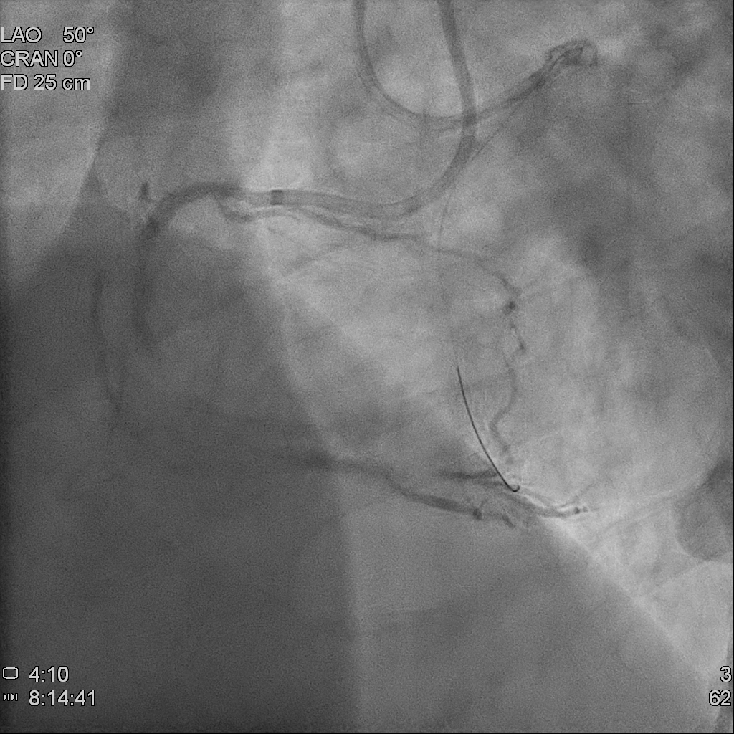
RCA: 2 CTO over RCA-M to D and RCA-PL

Slide 4
Successfully conquered the first CTO!
Right femoral approach
7 Fr. AL 1.0 with side-whole
Passed the lesion with ante-grade technique
Wire: Asahi XT-A

Slide 5
The length of the second CTO
Plan for this CTO:
Ante-grade approach
Enhance support with:
Guide extension: Telescope
Micro-catheter: Finecross, Sasuke
Wire escalation:
GAIA first
GAIA second
GAIA third
Judo 6
However, the lesion still could not be passed

Slide 6
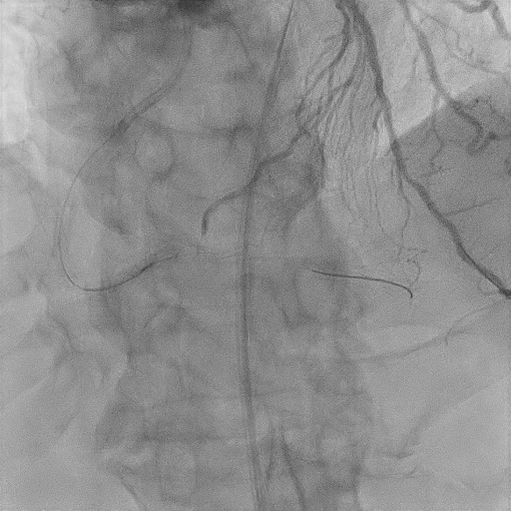
Wiring to RCA-PDA for the ostium lesion

Slide 7
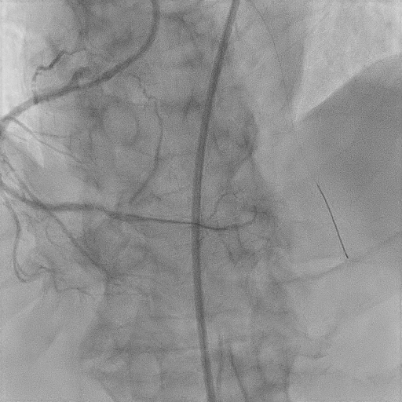
POBA to RCA-PDA ostium
The lesion was so tight that we could not dilate it even with NC balloon 2.75mm up to 30 atm

Slide 8
TPM was deployed for preparation of rotablation

Slide 9
Rotablation from RCA-D to RCA-PDA ostium
Rota-wire: floppy
Burr size: 1.25 mm
Speed: 149,000 to 179,000 rpm
Attempts: 3 times, each about 15 seconds

Slide 10
Improved flow after intervention to RCA-PDA
We then check IVUS from RCA-PDA to realize the possible orifice of RCA-PL. After the image study, we disclosed that the ostium of RCA-PL might be jailed by previous stent.
After comprehensive discussion, we stopped to the intervention to PL. We then shifted target to lesions over middle and proximal part of RCA.

Slide 11
Stent deployment to RCA-M
Pre-dilation: NC Emerge 3.5*30mm up to 24 atm
Stent: ONYX 3.5*30mm up to 16 atm

Slide 12
DEB for ISR over RCA-P to M
DEB: Agent 3.5*30mm up to 10 atm

Slide 13
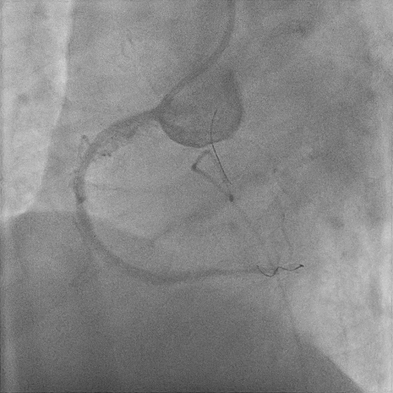
Final result: successful revascularization to total occluded RCA-M to D

