Slide 1
2024 TTT Live Demo
Chi-Mei medical center, case 4
Final report
AIMS: STEMI with MVD for complete revascularization
2024.01.07

Slide 2
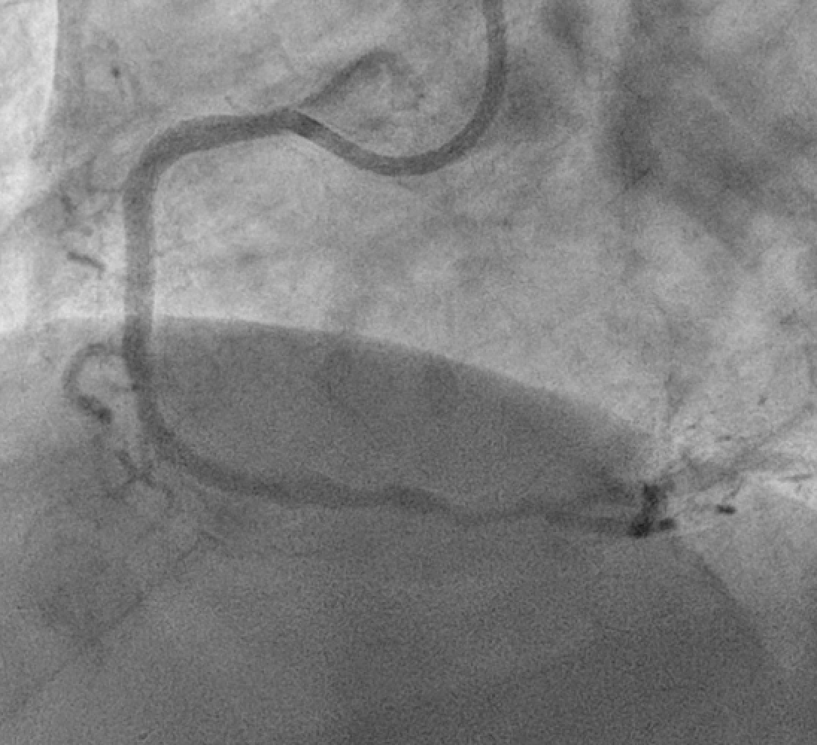
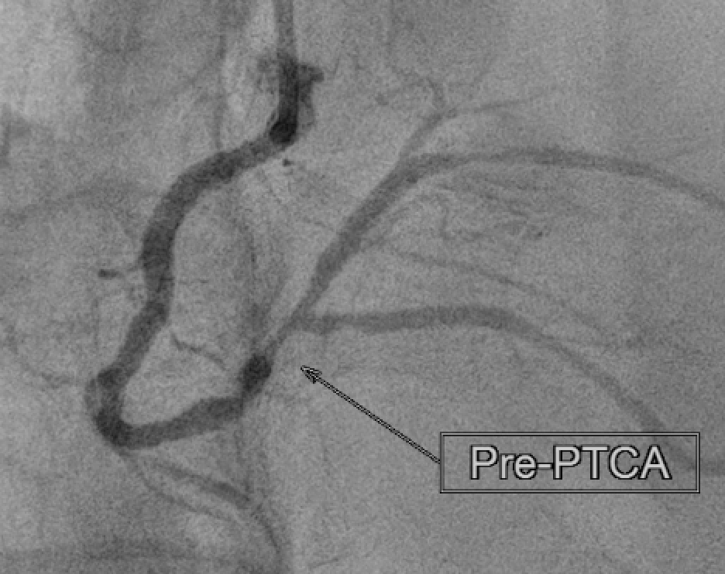
RCA:
Patent of previous stent during STEMI
Residual stenosis over RCA-D

Slide 3
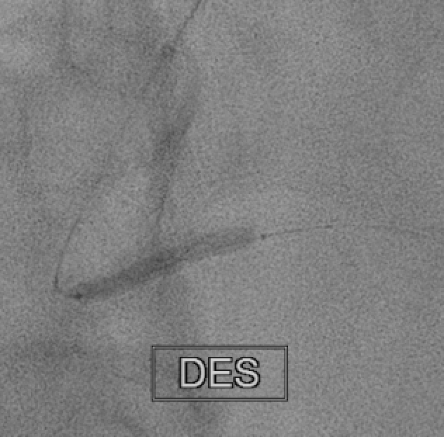
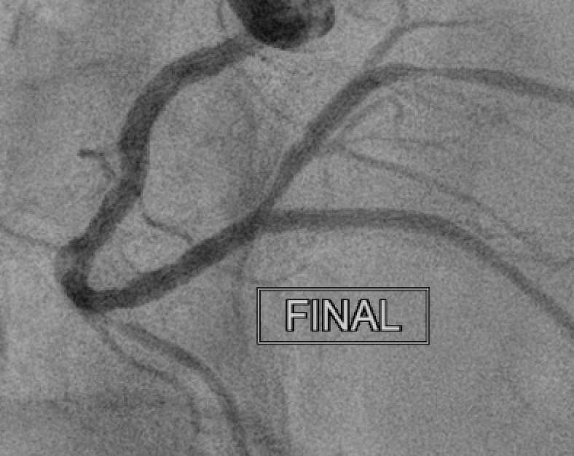
RCA:
DES Biofreedom 2.5x33 over RCA-distal
PL stenosis left it alone because to distal lesion

Slide 4
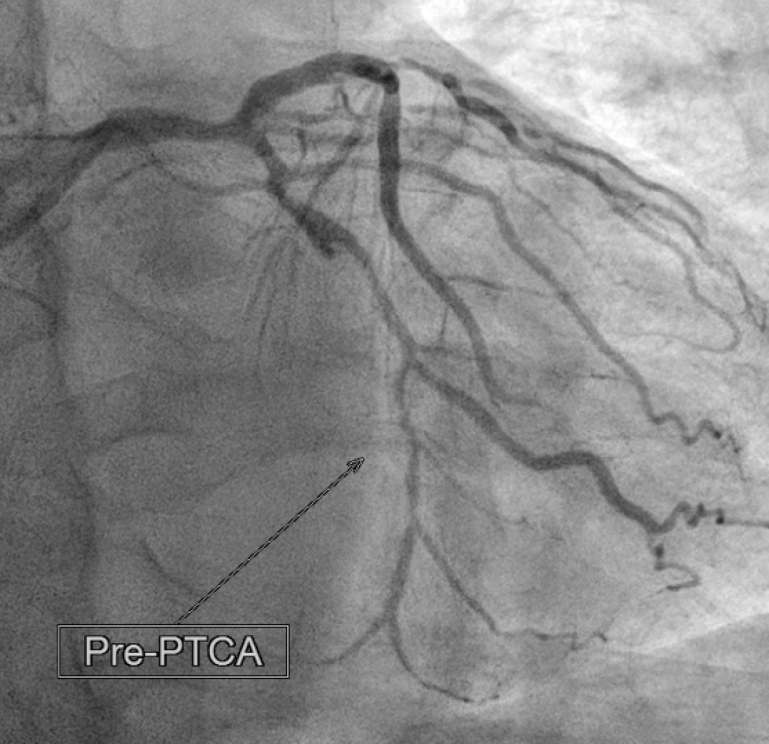
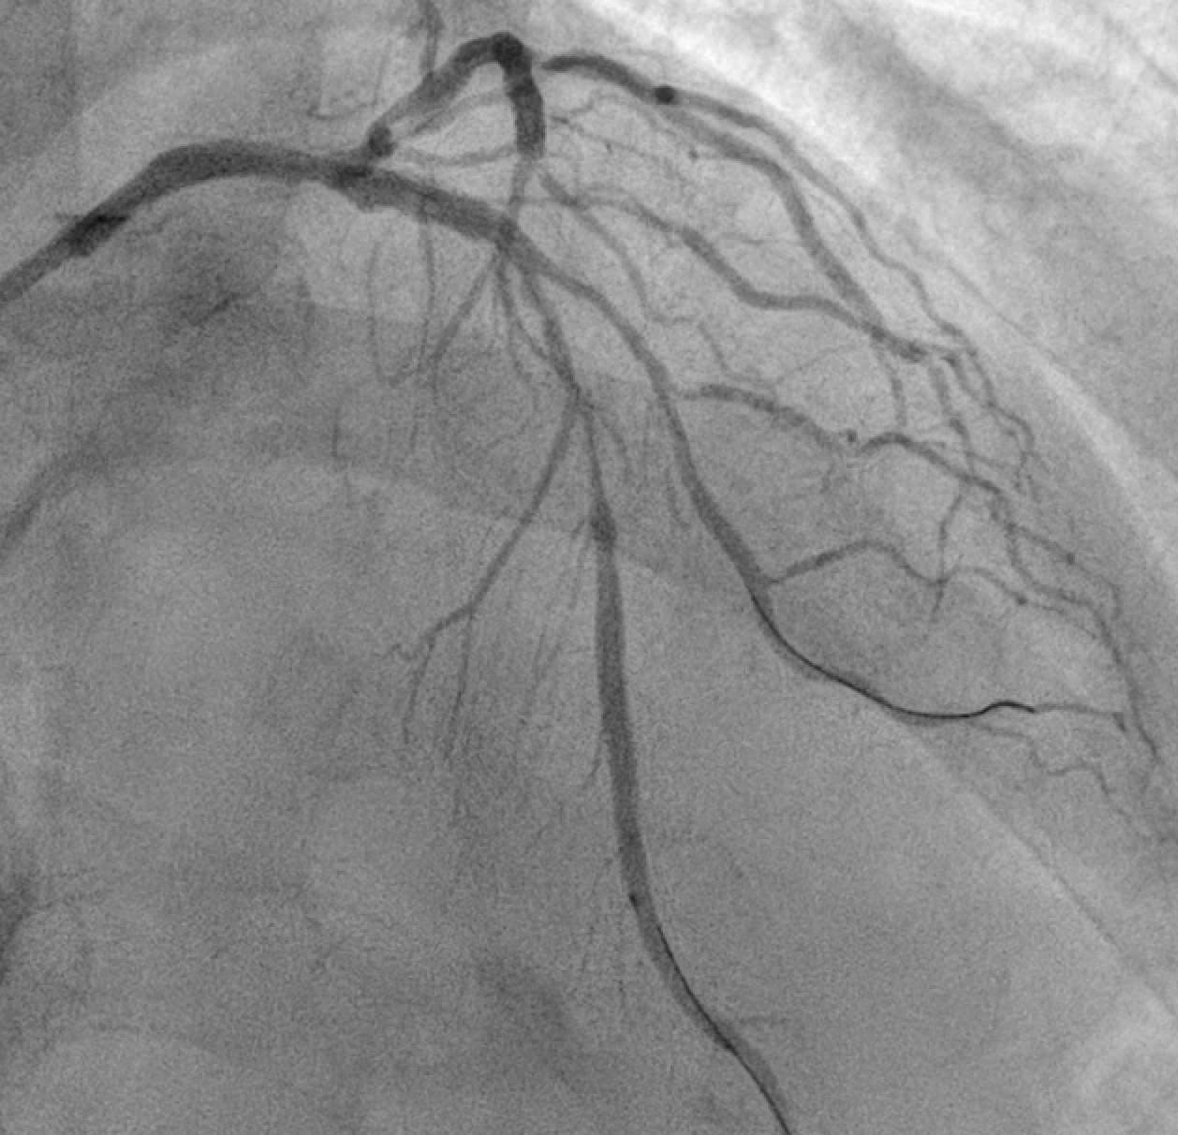
Multiple lesion
LM, LCX and LAD

Slide 5
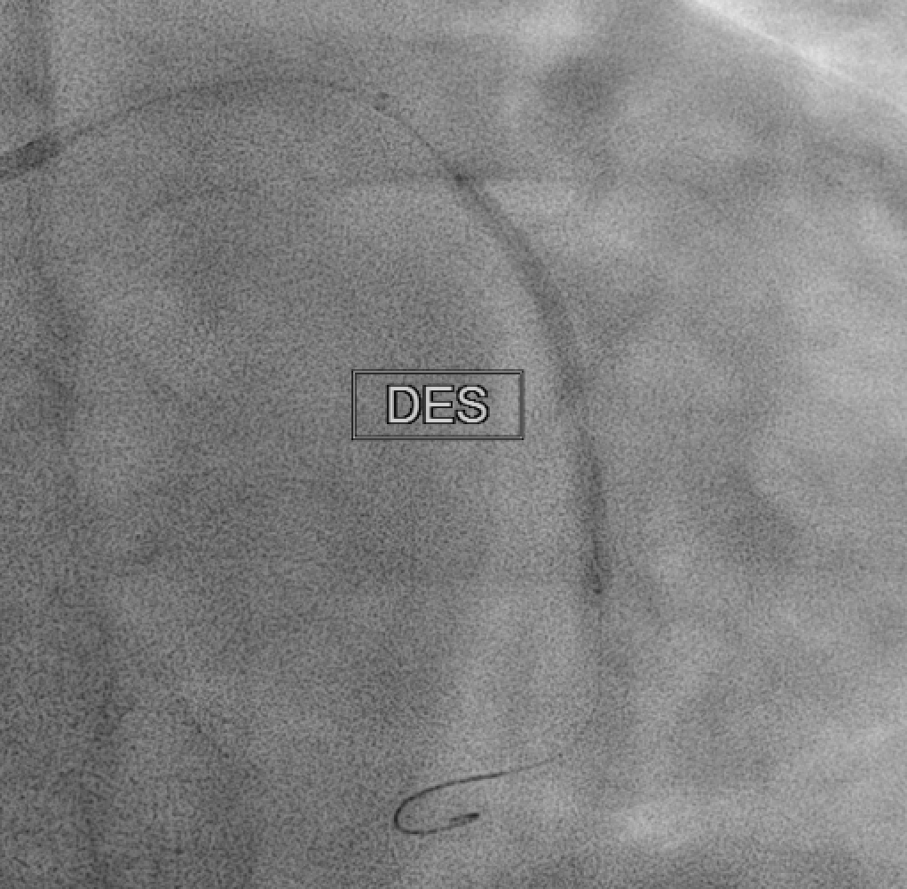
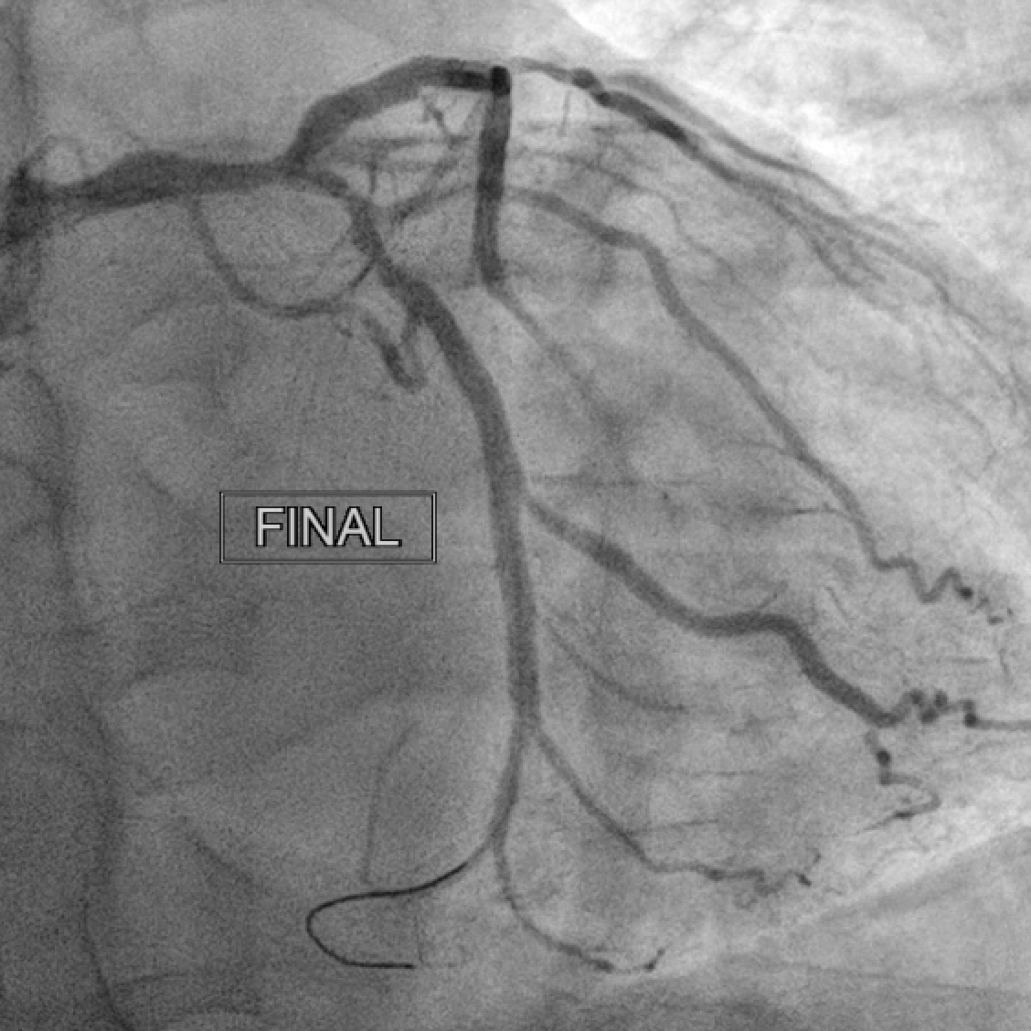
LCX: DES Biofreedom 2.5x36mm

Slide 6
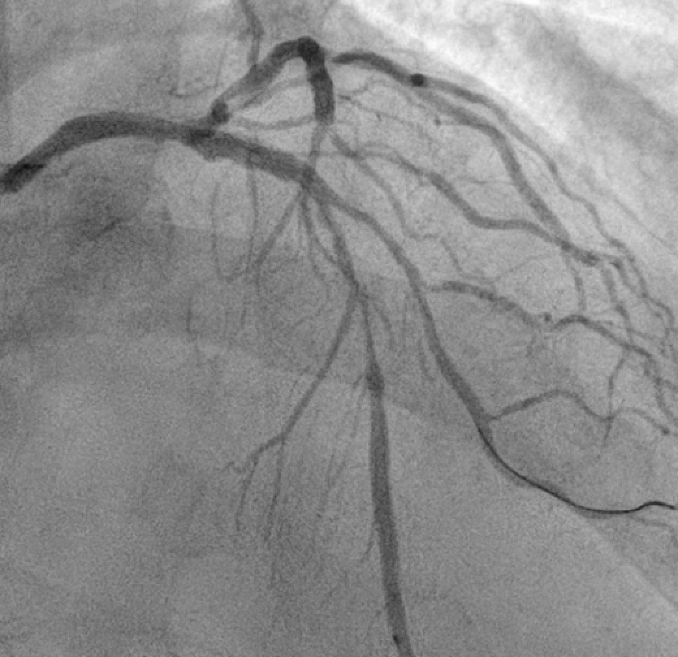
Discussion
LAD-diagonal bifurcation
Plan:
OCT image after predilated.
Provisional single cross over
Drug coating balloon for diagonal branch if jailed after stenting.
Treat left main lesion after OCT evaluation

Slide 7
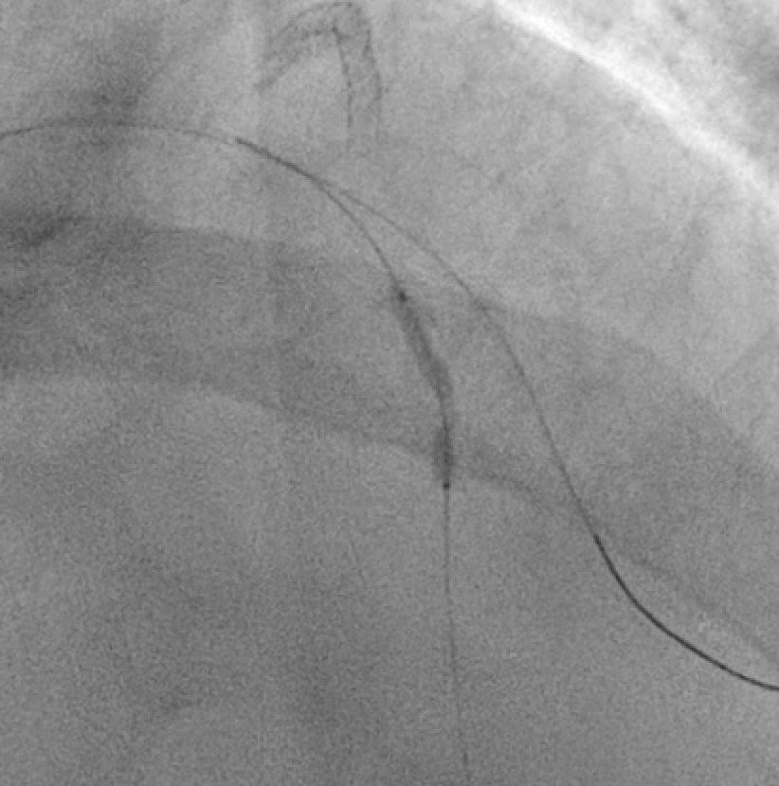
However..
LAD-M was not dilatable.

Slide 8
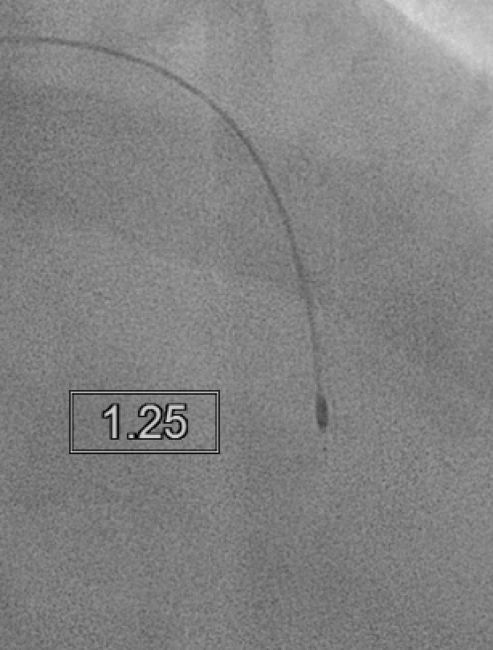
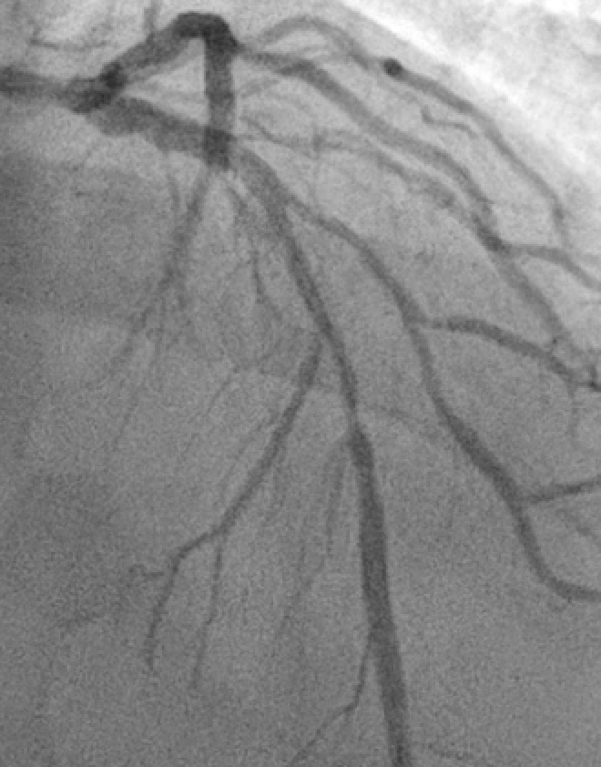
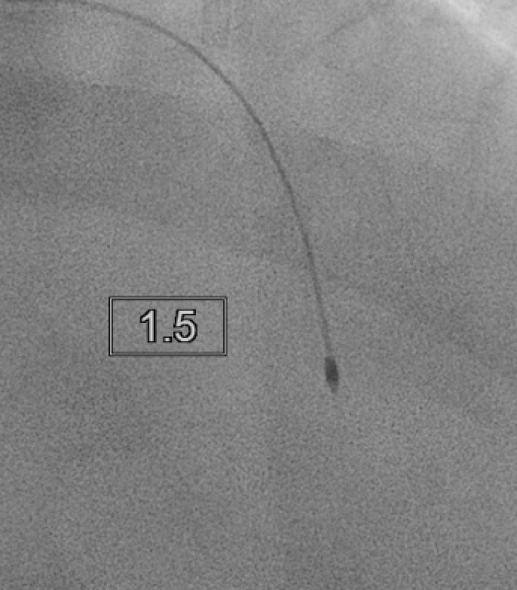
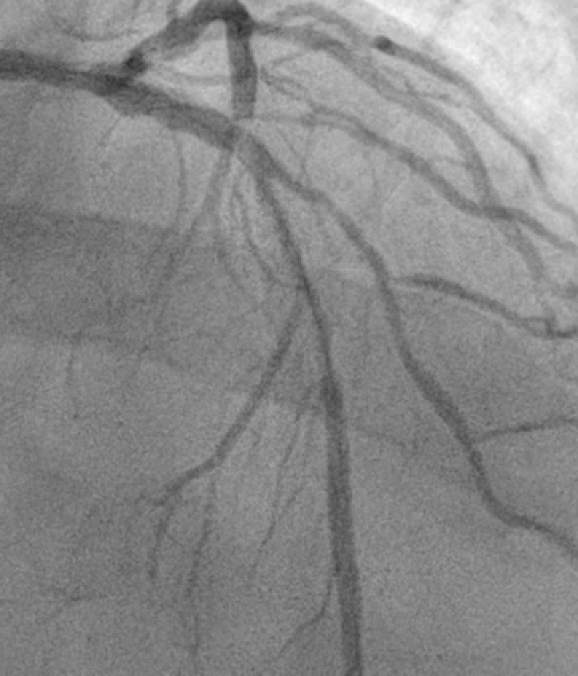
Rotalbation with 1.5 burr for 7 runs, but failed to pass
Changed to 1.25 burr for 4 times, passed.
Followed with 1.5 burr for 1 times, passed

Slide 9
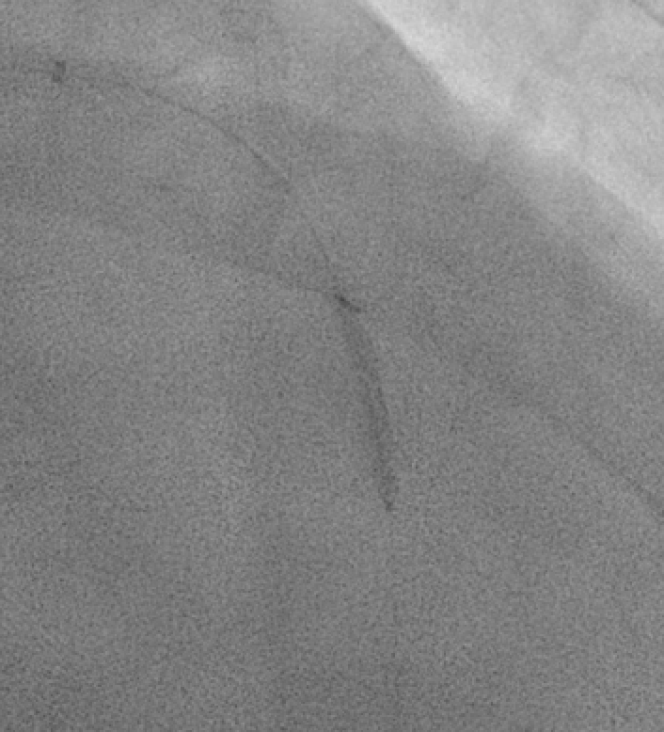
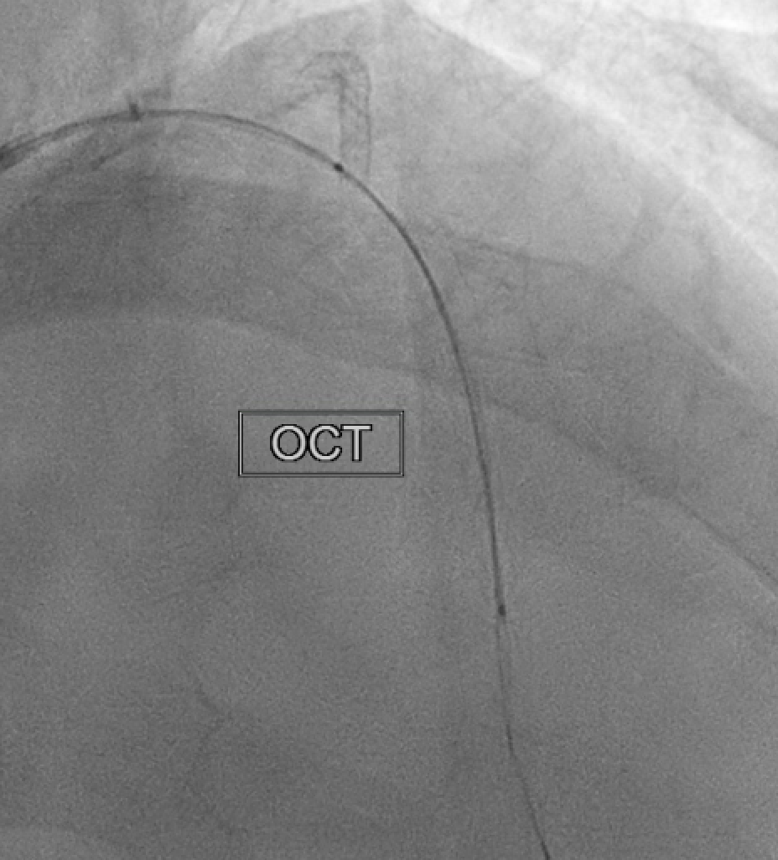
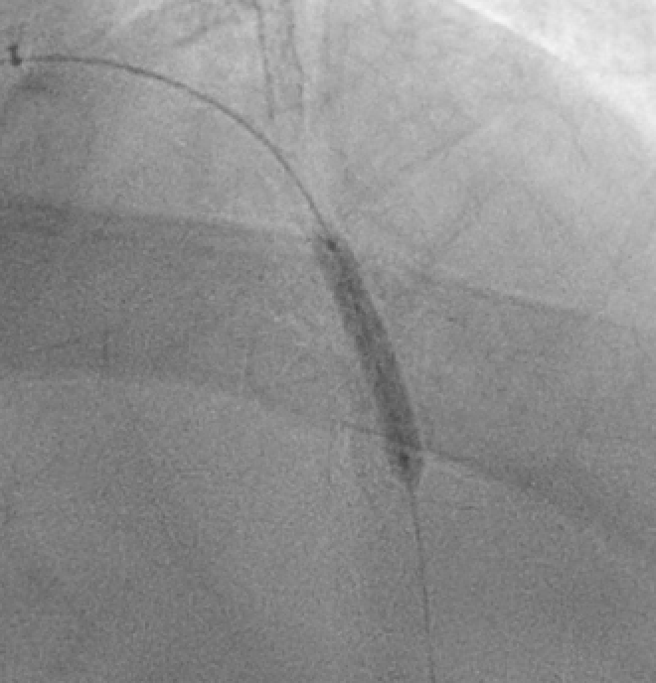
NC balloon 2.25x20 to 20atm, fully open
Then, OCT and followed with NC 3.0x20mm 20atm

Slide 10
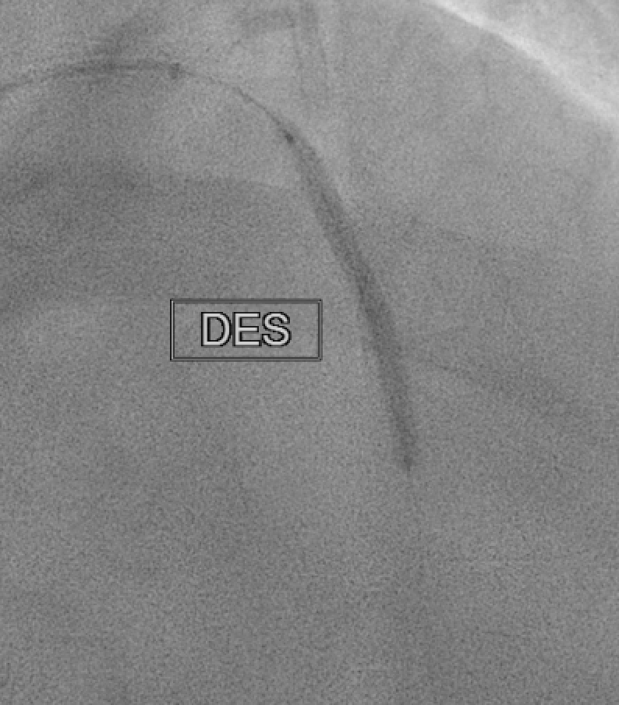
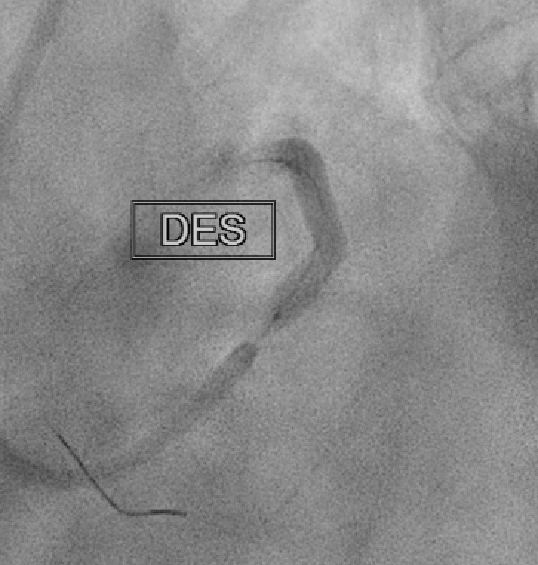
DES stenting:
Biofreedom 3.0x36mm and Biofreedom 3.5x36mm from LAD-M to LM after OCT guided

Slide 11
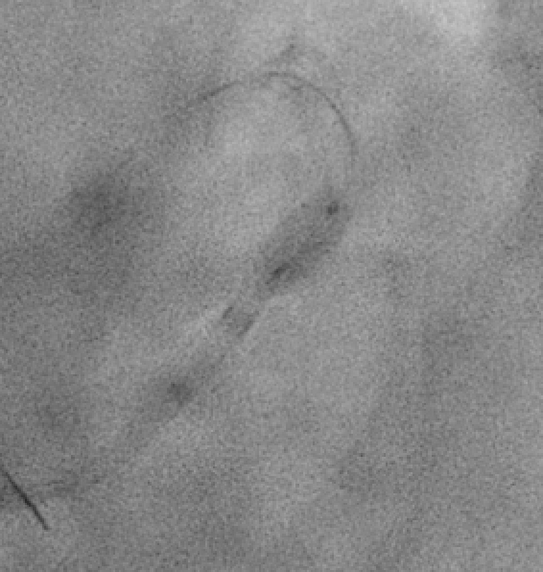
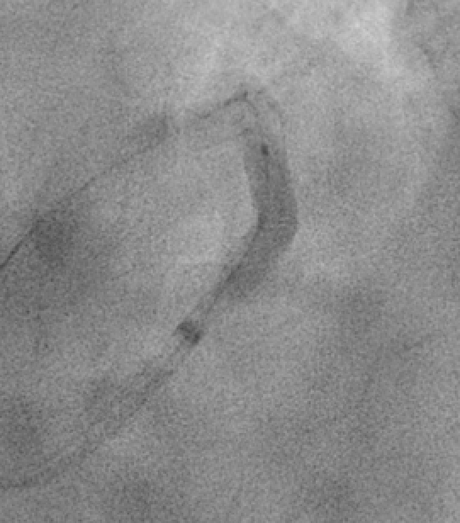
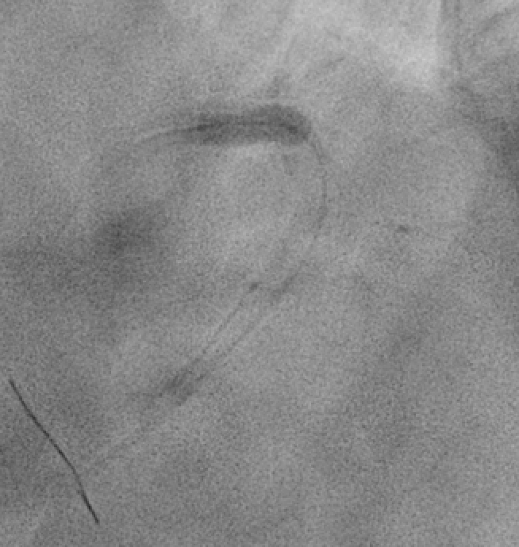
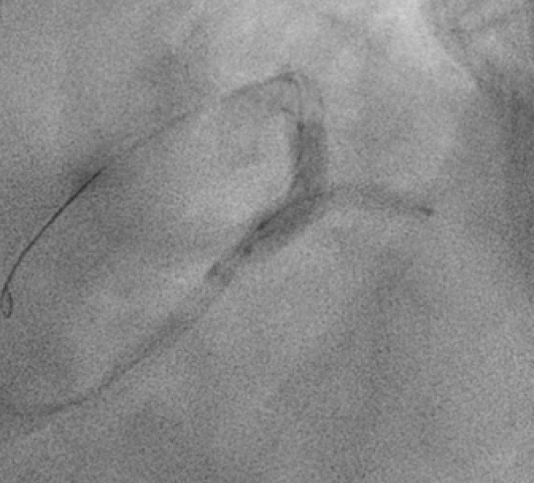
High pressure post dilated, Checked OCT after that.

Slide 12
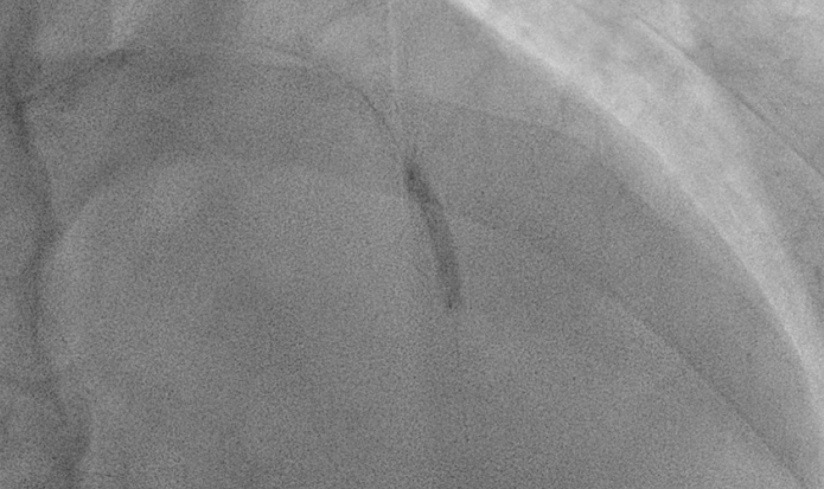
Most aggressive post dilated with higher pressure over the under-expanded area on OCT.

Slide 13
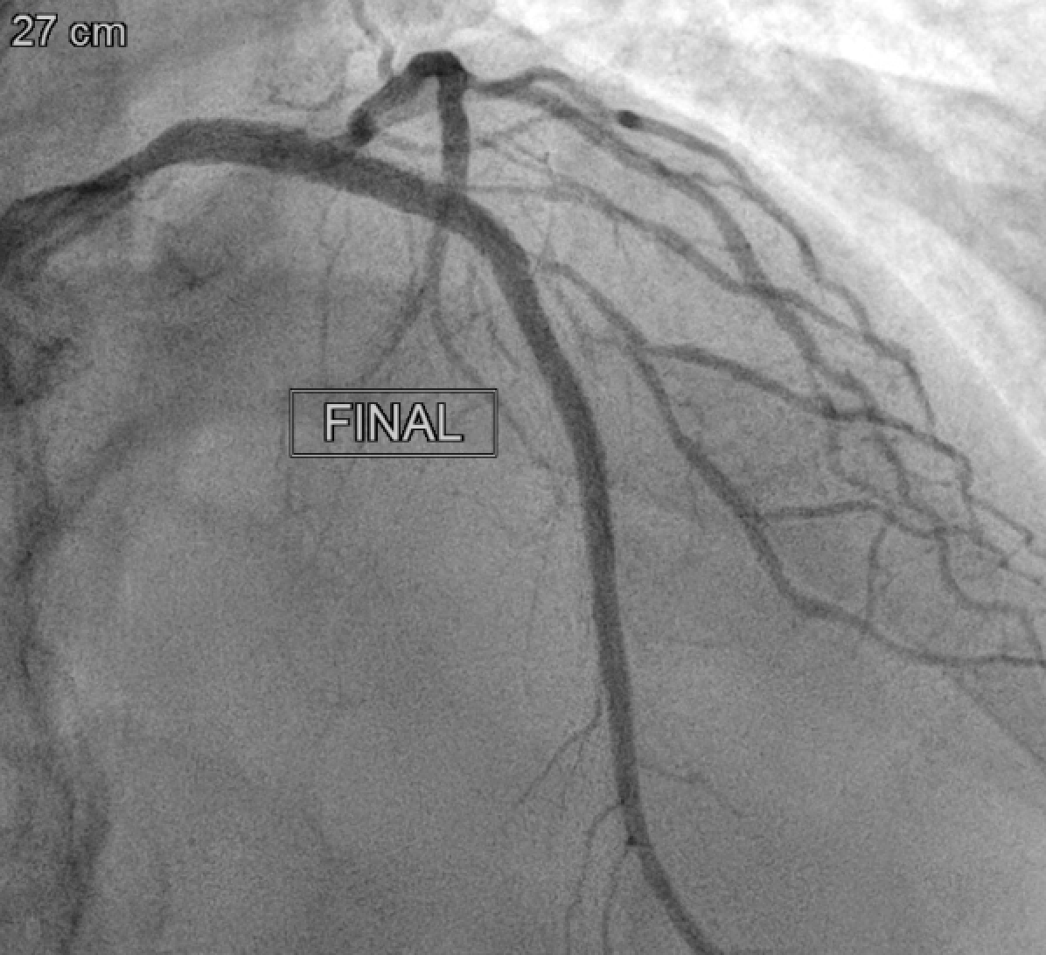
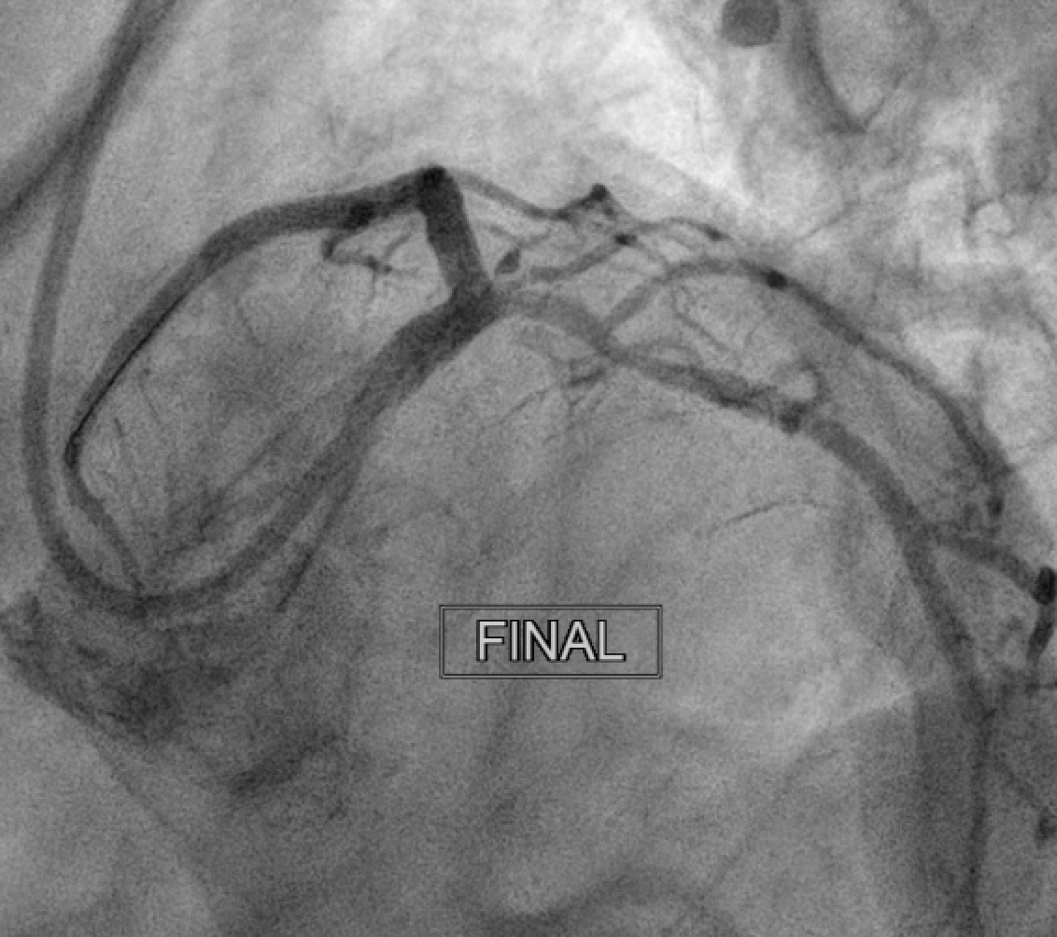
Final result: successfully finished complete revascularization for LM, LAD, LCX and RCA. Single cross over stenting for LAD-D2 bifurcation.
The patient discharged on next day

