Slide 1
Session II– Room 1：Left SFA CTO Operator: Dr. Wu
Clinical presentation
73 y/o male with left lower limb intermittent claudication for 2 months
Past medical history
Pulmonary embolsim
Hypertension
COPD
CAD with TVD
-s/p DES*1 at LAD -P to -M, DES*1 at LCx -M to -D, DES*2 at RCA -P to –D on 2022/11/11
Risk factors
Smoking(+) for 30yrs, 3 pack/day, Quit for 20yrs
Notes:
48806731

Slide 2
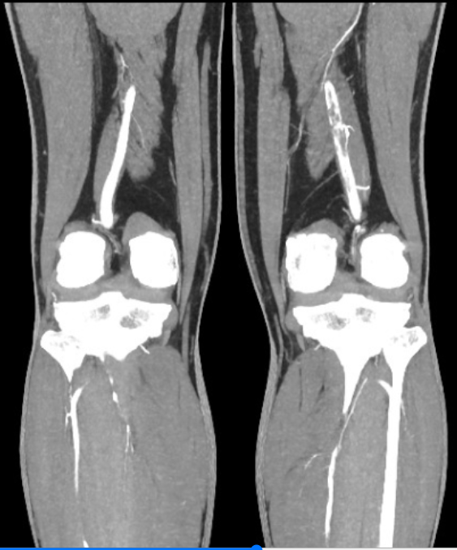
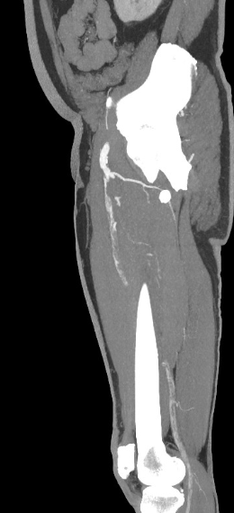
Session II - Room 1：Left SFA CTO
Operator: Dr. Wu
Target: Left SFA CTO
Right
Left

Slide 3
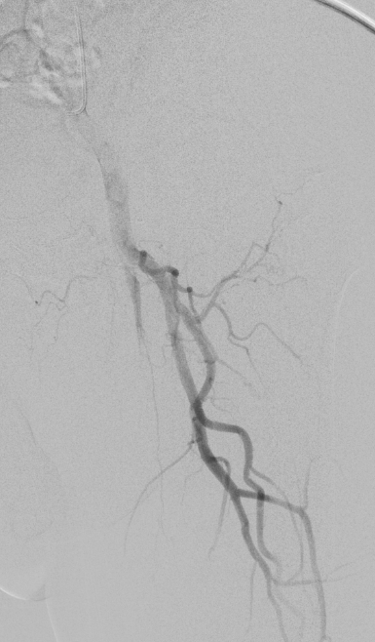
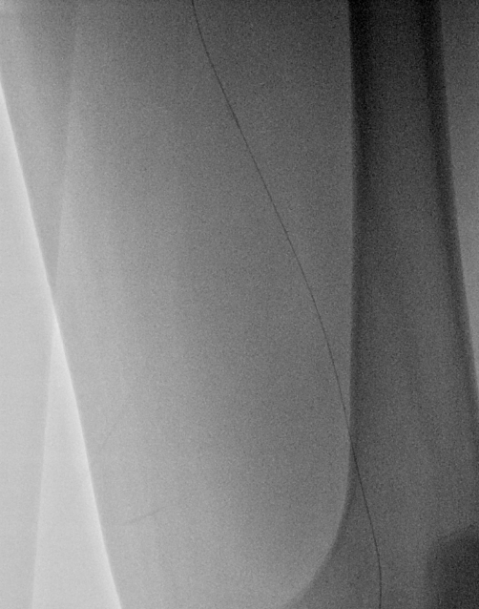
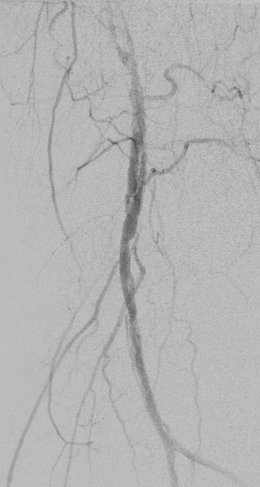
Diagnosis: Left SFA CTO
Wire crossing V18
Thrombus in SFA

Slide 4
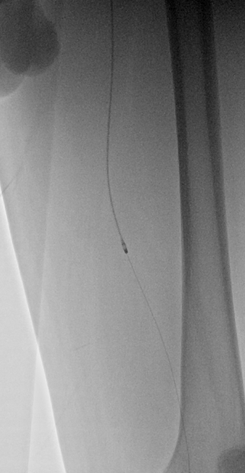
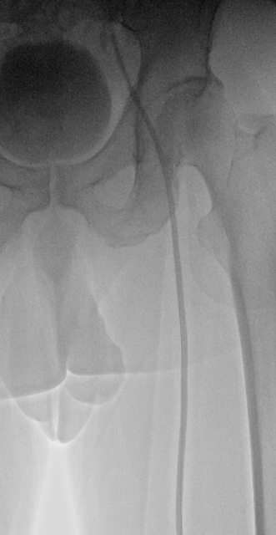
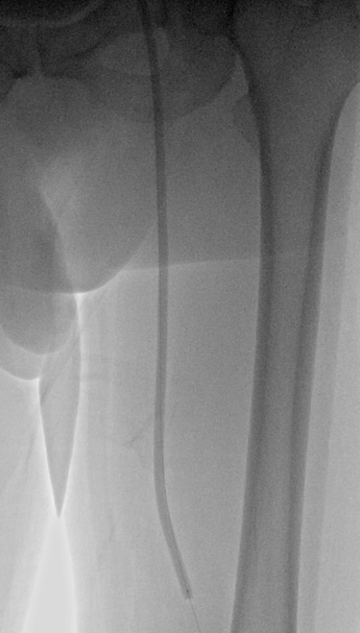
Rotarex thrombectomy
Sterling 2.0*150mm balloon catheter
Sterling 5.0*280mm balloon catheter

Slide 5
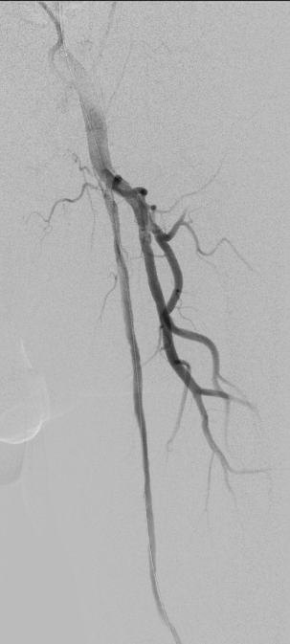
Before PTA
Final angiography

