Slide 1
Session II– Room 2：RCA CTO Operator: Dr. Lee
Clinical presentation
66 y/o male with exertional chest tightness for months
Past medical history
Type 2 DM, HBA1c=6.4 on 2022/12/6
Hypertension
Hyperlipidemia
Notes:
48806731

Slide 2
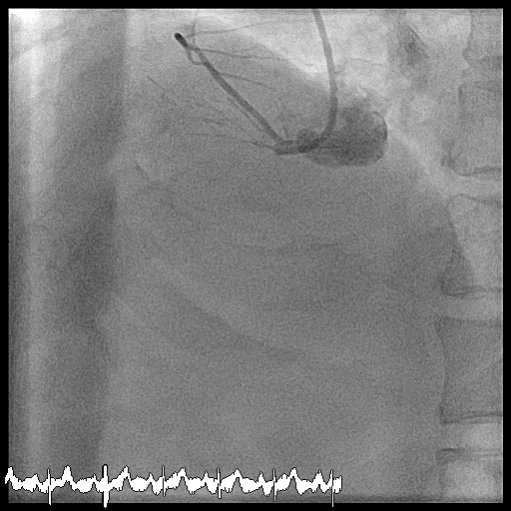
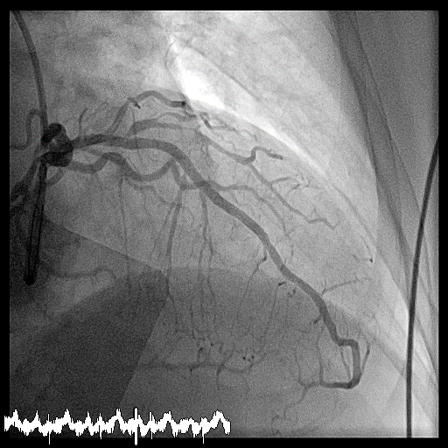
Session II- Room 3 : RCA CTO
Operator: Dr. Lee
Target: RCA CTO, Syntax score: 32
Syntax score: 32
J-CTO: 3 | blunt, calcification, length

Slide 3
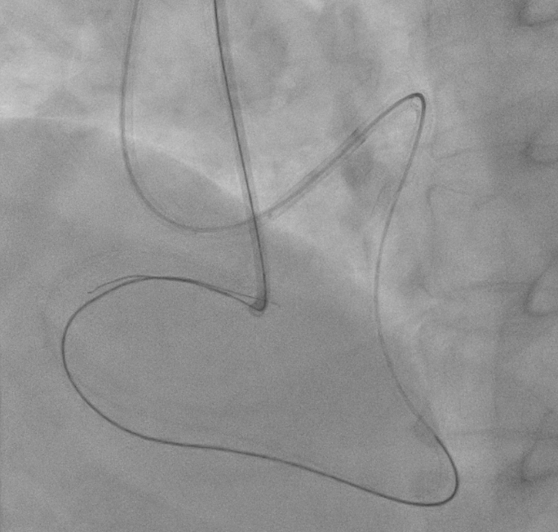
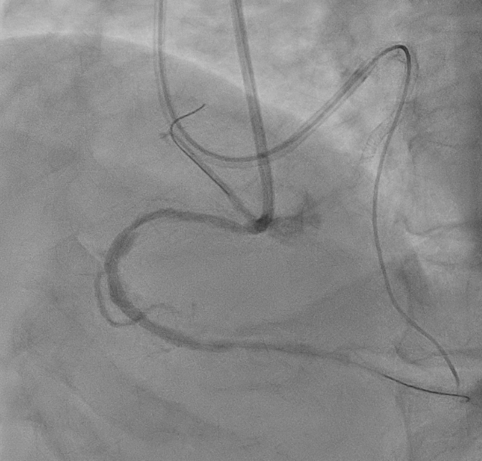
kissing wiring technique
Successfully wire crossing w/ distal wire in true lumen

Slide 4
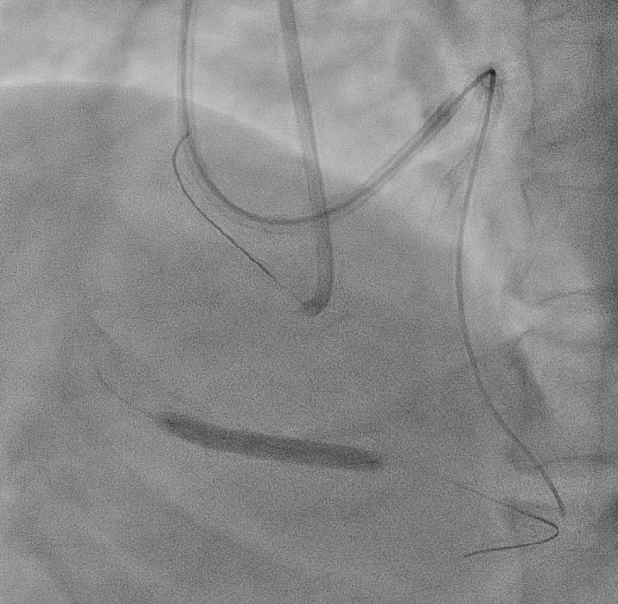
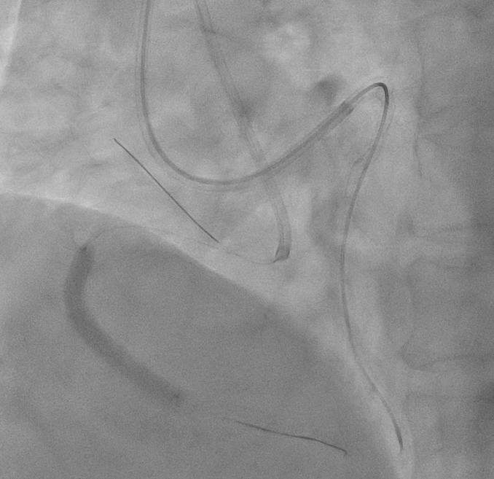
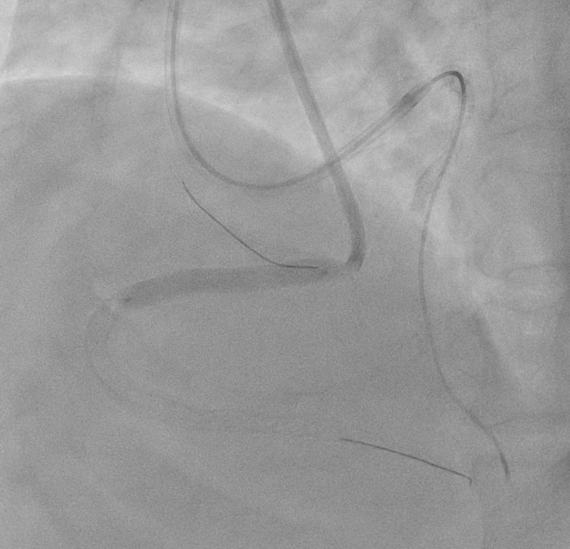
Onyx 4.0 x 30 mm DES
Onyx 4.0 x 38mm DES
Onyx 4.0 x 34 mm DES

Slide 5
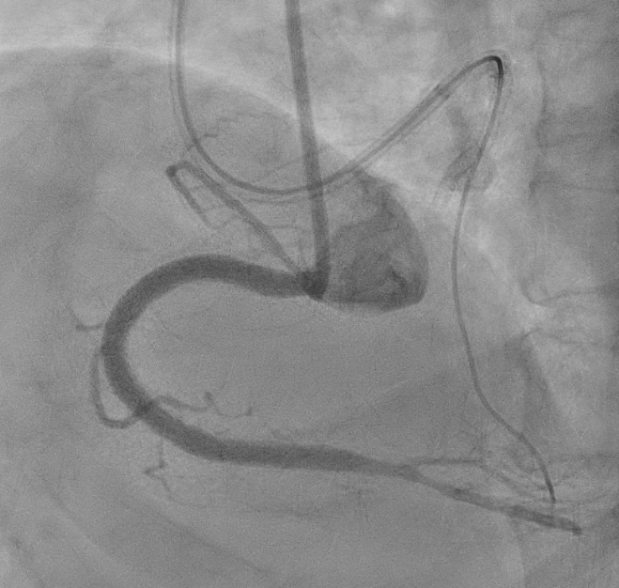
Before PCI
Final angiography

