Slide 1
Case 1 : Stroke on OAC
Date : 2024/01/06
Operator : Dr. Jung Cheng Hsu
Far Eastern Memorial Hospital
Notes:
242539

Slide 2
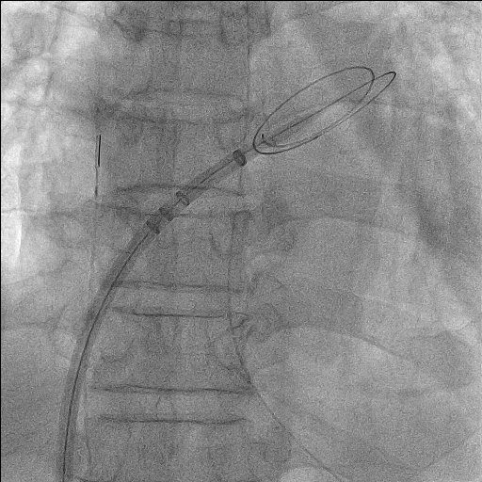
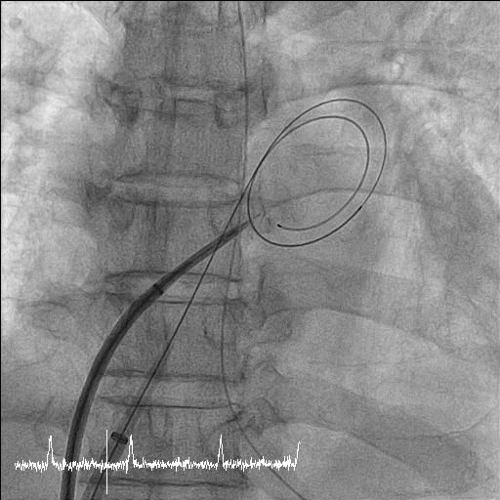
Transeptal procedure under ICE guidance
Retrieve ICE and another transeptal sheath for ICE into LA

Slide 3
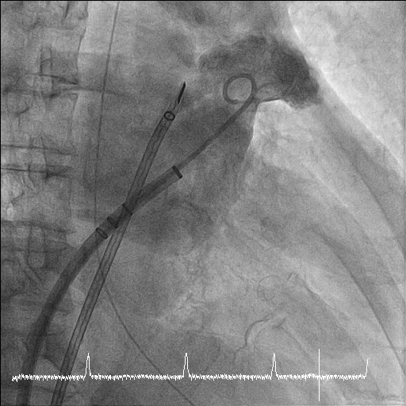
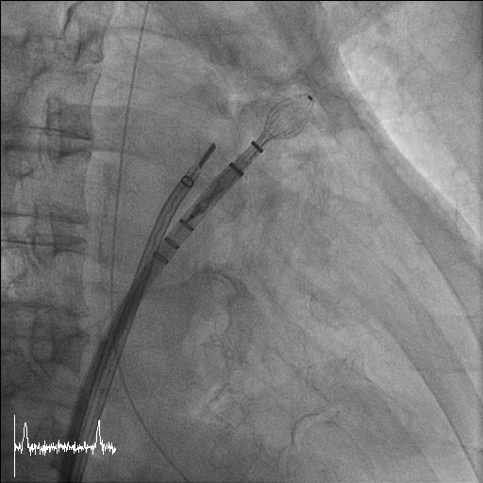
Contrast Injection via Pigtail catheter for LAA size measurement
LAA occluder implantated into LAA

Slide 4
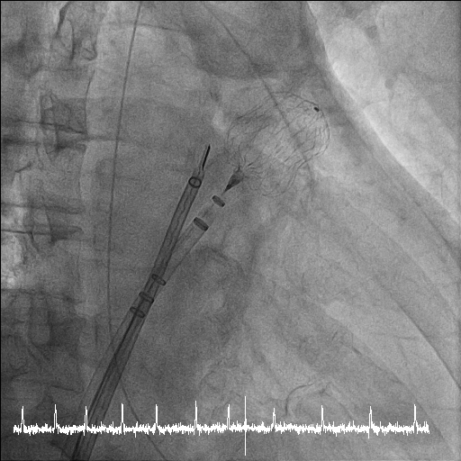
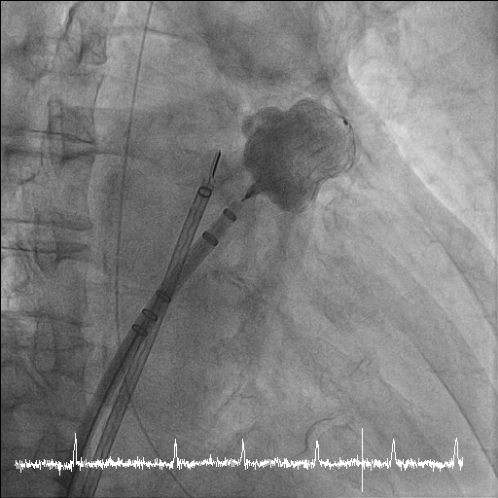
Tug test before deployment
Contrast injection without peri-device leakage

Slide 5
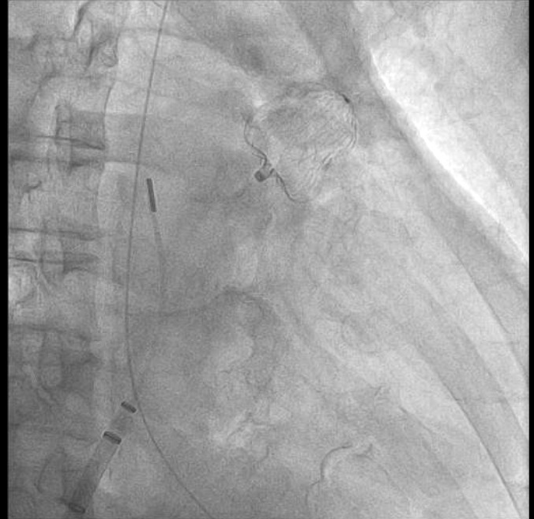
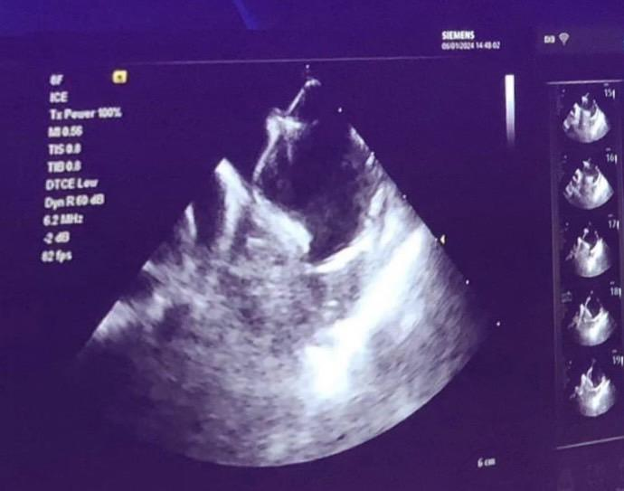
Results of LAAO with Watchman Flx (31mm), compression ratio around 0.20
Final ICE imaging

Slide 6
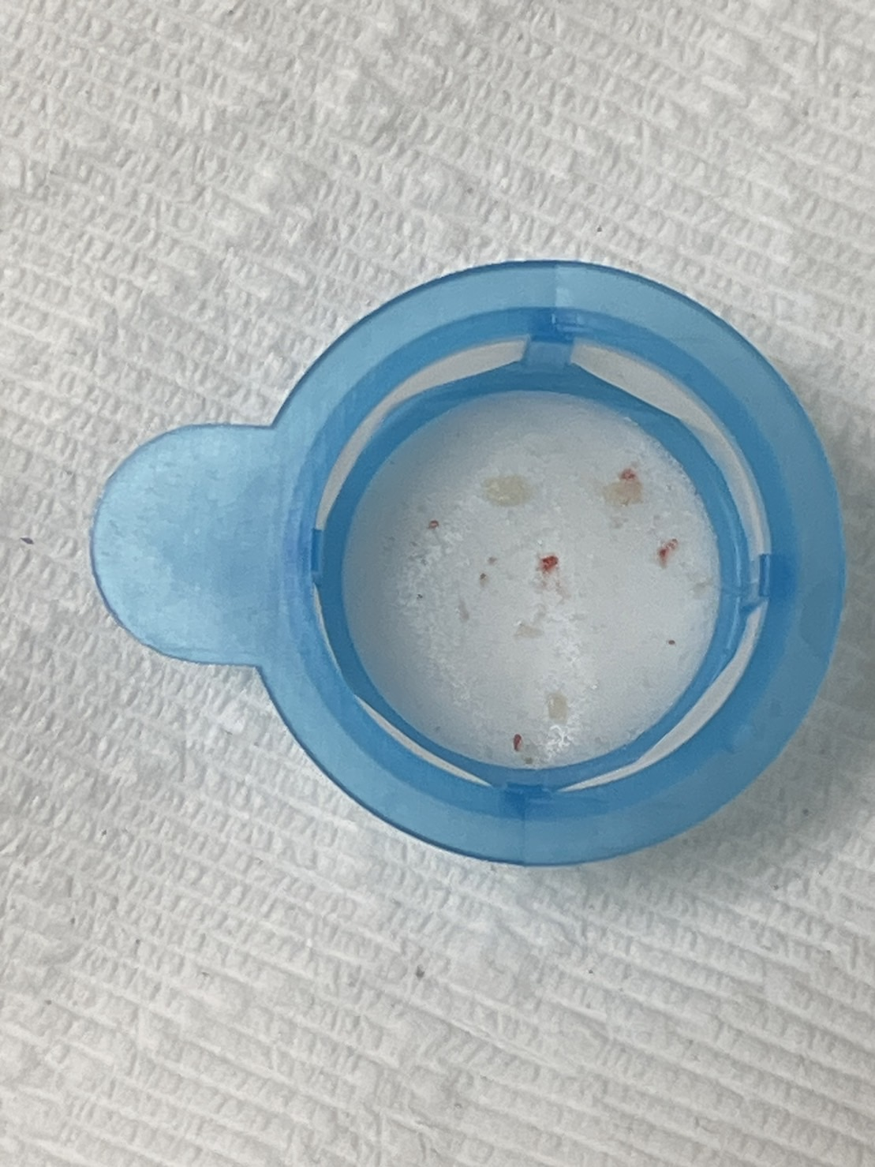
small thrombus got from SENTINEL cerebral protection system

Slide 7
The patient continued to receive Rivaroxaban 20mg once daily post-procedure and underwent physical rehabilitation. We intend to transition the patient to Rivaroxaban 15mg once daily during the outpatient department visit, because this patient was also a high bleeding risk patient.

