Slide 1
Case 2: LAD calcified lesion
Date: 2024/01/06
Operator: Drs. Tien-Ping Tsao/ Chung-Ming Tu
Far Eastern Memorial Hospital

Slide 2
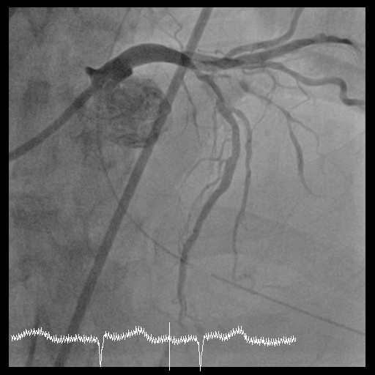
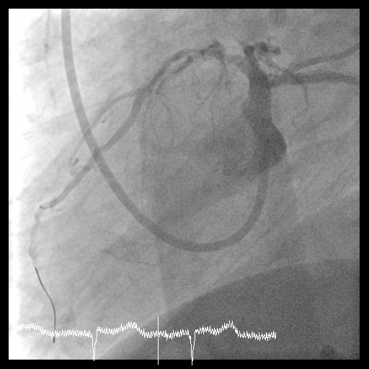
Punctured then sent wire and sheath via right femoral artery.
Initial angiography: LAD proximal: 90%, LAD mid: 85%, LAD D1: 90%, LCx distal: 50% stenosis.

Slide 3
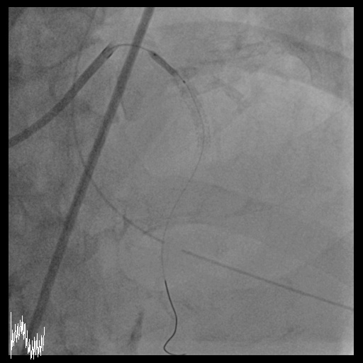
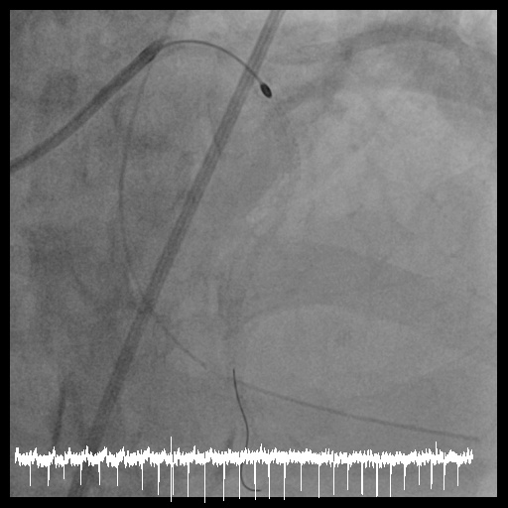
Wire cross then POBA to LAD proximal.
OCT was done, which revealed severe calcification (360 degree) in-stent and outsite stent. Rotablation was performed with 1.75 burr

Slide 4
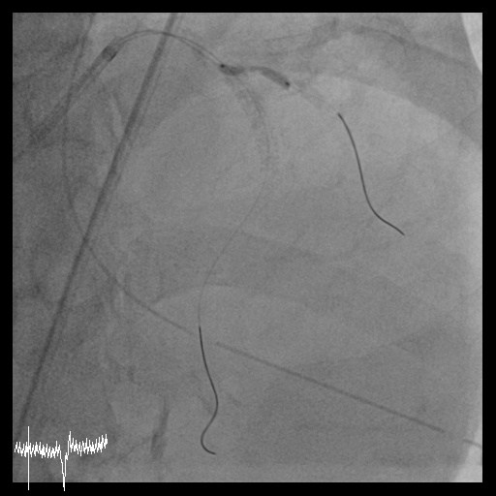
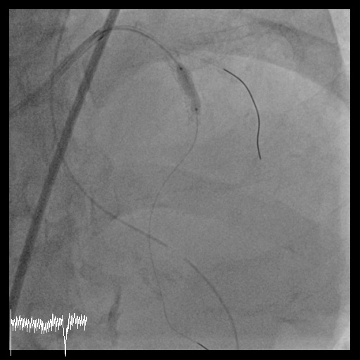
Microcatheter with wire went through D1, then POBA to D1 proximal.
IVL(3.5X13mm) and cutting balloon(3.5X10mm) dilatation were performed from LAD proximal to mid.

Slide 5
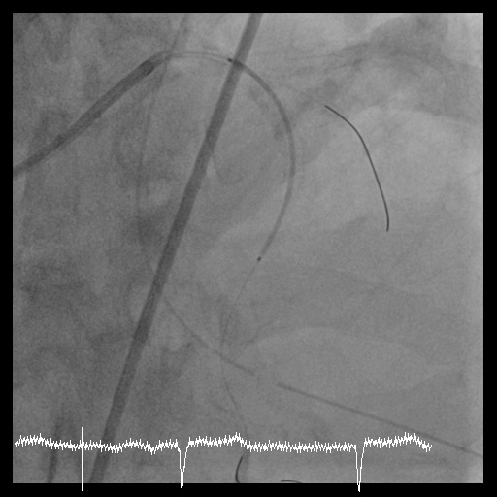
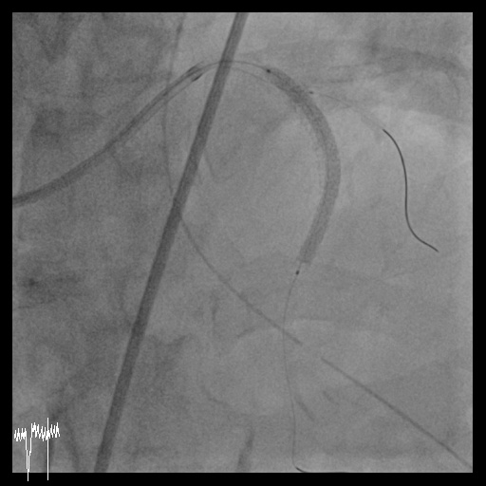
A 3.0*48mm DES was placed from LAD proximal to mid, then POT to 3.5mm with jailed balloon technique
Final OCT showed 97% expansion rate and MLA=7.8mm² after stenting.

Slide 6
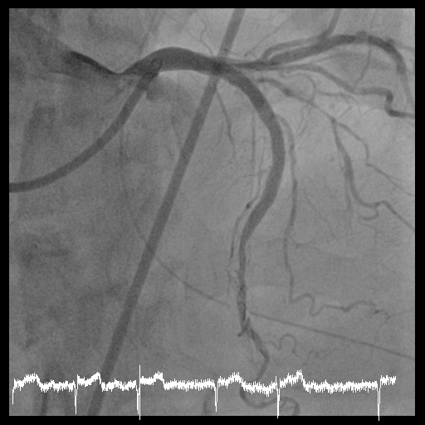
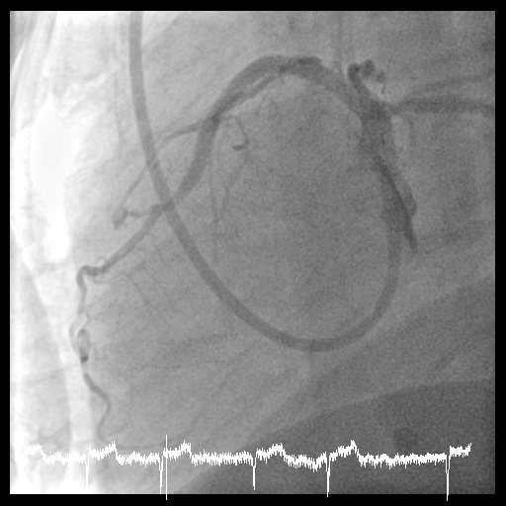
Final angiography showed TIMI 3 blood flow.
Right femoral artery puncture site was sealed by 8Fr angioseal.

Slide 7
Post-procedure care
We kept medication with dual antiplatelet agents, beta-blocker, and ARB after the procedure.
EKG and cardiac markers were checked on the next morning, which had no remarkable finding.
The patient denied chest tightness, nor any other discomfort. We let him discharge and follow up at outpatient clinic.

